Slide 1
Chapter 1
Atoms, Elements and Compounds.

Slide 2
Science Safety
BRAINSTORM
What are some rules that are important for lab safety?

Slide 3
Science Safety
Read Safety Rules for the Science lab on page 10
WHMIS: Workplace Hazardous Materials Information System: Used to ensure that everyone has access to useful safety information about a hazardous substance they may encounter that is manufactured or sold.

Slide 4
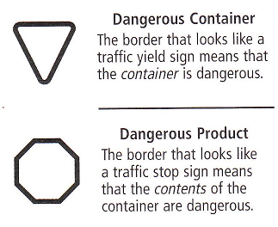
Safety
Hazard symbols: a warning printed on a container to indicate that either the container or the product is dangerous
Shape of border for the symbol tells if the container or the contents are dangerous

Slide 5
Hazard Symbols
The picture inside identifies the type of hazard- explosive, corrosive, flammable, or poisonous.

Slide 6
MSDS: Material Safety Data Sheets
All chemicals that will be used in the lab come with MSDS information.
MSDS contain Nine different sections .
Provides valuable information about the safe handling and disposal of chemicals, safety precautions, spill procedures and first aid requirements.

Slide 8
Investigating Matter
Matter: anything that has mass and volume
Mass: the amount of matter in a substance (often measured in grams)
Volume: the amount of space a substance occupies (often measured in liters)
Element: a substance that contains only one kind of matter and cannot be broken down or separated into simpler substances.

Slide 9
Properties of Matter
Physical Properties: are characteristics of matter that are often observed (qualitative - words) or measured (quantitative - numbers)
Table 1.1 page 18

Slide 10
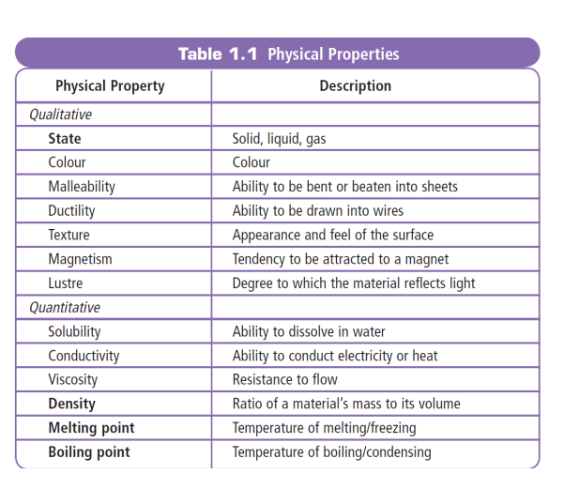
Properties of Matter

Slide 11
Properties of Matter
Chemical properties: are characteristics that can be observed when substances react with each other
Table 1.2 page 19

Slide 12
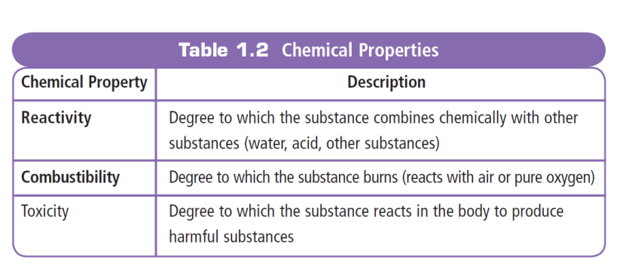
Properties of Matter

Slide 13
Task
Activity 1-2B: A chemical Family (page 19)

Slide 14
Core Lab (page 20)
Physical and Chemical Properties

Slide 15
Section 1.2: Theories vs. Laws
Laws: are descriptions of events, patterns, or relationships that have been observed over and over again. They do not explain they just state what happens
Laws are constant, they rarely change
Theories: are explanations of observations that are supported by reliable evidence.
Sometimes theories are modified or rejected because they cannot support new evidence.

Slide 16
Atomic Theory
Atomic Theory: the various descriptions of matter and how it behaves
Changes in Atomic Theory
Empedocles: 2500 years ago, said that matter was made up of earth, air, wind and fire and was not based on any evidence
Democritus: any substance when cut into smaller and smaller pieces, would eventually end up with a piece that could not be further divided (a piece called atomos). Aristotle agreed with this theory
No one challenged this idea for about 2000 years. Why?

Slide 17
John Dalton
Often called the billiard ball model because he saw the atom as being the same throughout and indivisible.
Dalton’s Atomic Theory (4 points)
All matter is made of small particles called atoms
Atoms cannot be created, destroyed or divided into smaller particles
All atoms of the same element are identical in mass and size, but they are different in mass and size from other elements
Compounds are created when atoms of different elements link together in definite proportions

Slide 18
J. J. Thomson
Proposed a raisin bun model of the atom
He saw the negative electrons as being scattered throughout the positive area of the atom much the same as raisins are in a bun
Atoms have smaller particles called electrons (negatively charged particles)
A short lived theory

Slide 19
Ernest Rutherford
He was a student of J. J. Thomson
Planetary model because he saw the electrons as circling the center of the atom like the planets circle the sun.
He discovered the nucleus (tiny, heavy, positively charged center of the atom). He thought the rest of the atom was empty space.
Later he established that there are at least two other kinds of particles inside the nucleus of the atom
Proton: positive electric charge
Neutron: has no electric charge

Slide 20
Niels Bohr
A student of Rutherford
Orbital model because he saw the electrons as circling the nucleus at different energy levels.
He proposed that electrons surround the nucleus in specific energy levels or shells.
Each electron has specific energy and when they move from one level to another, energy is released.

Slide 21
Structure of the Atom
Atom: the smallest particle of an element that keeps the properties of the element.
All atoms are made up of three kinds of smaller particles called subatomic particles, protons, electrons and neutrons.
Subatomic particles are too small to see and our understanding of the atom is based on physical and chemical experiments
If an atom was the size of a football field then the nucleus would be a grain of sand in the center of the field.
Nucleus: a tiny region at the center of the atom.

Slide 22
Comparing Subatomic particles
 | Proton | Neutron | Electron
Symbol | P | N | e
Relative Mass | 1836 | 1837 | 1
Charge | + | 0 | -
Location in the atom | Nucleus | Nucleus | Surrounding the nucleus

Slide 23
Electrons surround the nucleus in energy levels and cannot be found in the nucleus.
Protons and neutrons are found in the nucleus and CANNOT LEAVE.
The nucleus always has a positive charge because it contains only positive and neutral subatomic particles.
The energy levels are always negative because they only contain electrons.

