Slide 1
Chapter 11

Slide 2
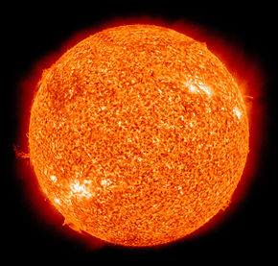
The Sun

Slide 3
Sun 101
Criteria
Mass | Contains 300 000 times more mass than Earth
Motion | Rotates
Composition | Contains hydrogen and helium atoms
Function | Chemical reactions in the sun give off electromagnetic radiation, including heat and light which support life in our solar system.
Special Features | Contains sunspots, solar flares, and solar prominences.

Slide 4
Sun 101, cont’d. Page 392
Sunspot
Dark patches on the sun.
Solar Flare
Extremely violent eruptions of gas.
Solar Prominence
Large loops of super-hot gas that extend from the Sun’s surface.

Slide 5
Solar Wind
streams of high-energy particles ejected by the sun
Exposure to this solar wind could be fatal but Earth’s magnetic field deflects most of the solar wind around the planet
http://www.youtube.com/watch?v=2zOlkIyg3iE

Slide 6
Solar Wind, cont’d
Some of these high-energy particles collide with gases in the atmosphere at the North and South poles.
The results are natural light shows called the auroras
Aurora Borealis – Northern Lights
Aurora Australis – Southern lights
https://www.youtube.com/watch?v=lT3J6a9p_o8

Slide 7
Space Weather
Conditions produced by the Sun that have an effect on the inner solar system, and particularly on technological devices on or near Earth; may also effect human health
https://www.youtube.com/watch?v=P-dEVzuaSiw
https://www.youtube.com/watch?v=GRst061YTVU

Slide 8
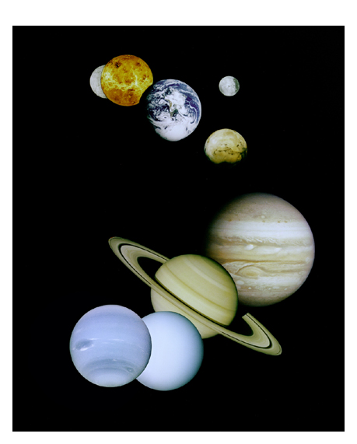
The Planets

Slide 9
The Planets, cont’d
Mercury, Venus, Earth, Mars, Jupiter, Saturn, Uranus, Neptune
My very educated mother just served us nachos.
If that doesn’t help you remember the order, come up with a sentence of your own.

Slide 10
The Planets, cont’d
The planets are divided into two broad categories:
1) Terrestrial
Inner rocky planets
Mercury, Venus, Earth, and Mars
2) Jovial
Outer gaseous planets
Jupiter, Saturn, Uranus, and Neptune

Slide 11
Terrestrial vs. Jovian Planets
Criteria | Terrestrial Planets (inner) | Jovian Planets (outer)
Size | Small (all Earth size or smaller) | Large (4-11 times larger than Earth)
Motion | Slow spinning, small orbits | Faster spinning, large orbits
Composition | Solid and rocky | Gaseous
Distance from Sun | Closer | Farther away
Temperature | Warmer, but temperatures vary | Colder but temperatures vary
Density | Greater | Less

Slide 12
Astronomical Unit
The measure from the Earth to the Sun; roughly equal to 150 million kilometres.
Earth is 1 AU from the sun.
Jupiter is 5.27 AU from the sun
How many kilometres from the Sun is Jupiter?

Slide 13
Planet Videos
Inner Planets:
http://www.youtube.com/watch?v=qVItSWKQiuQ
http://www.youtube.com/watch?v=X0TP-p8TLf4
Outer Planets:
http://www.youtube.com/watch?v=ICutVnjsx1o

Slide 14
Planet Rules
To be considered a planet, objects need to:
1. Orbit the Sun
2. Have enough gravity to a have a near spherical shape.
3. Cleared out everything from its orbital path.
Pluto fails the last criteria since it is only 0.07 times the mass of everything in its orbital path.
Objects that failed one of the planet rules are called Dwarf Planets, like Pluto.
Other examples of dwarf planets are: Eris (larger than Pluto), Haumea, Makemake, and Ceres.

Slide 15
Dwarf planets, cont’d
What happened to Pluto?
http://www.youtube.com/watch?v=pTZMgoh663I

Slide 16
Other Celestial Bodies

Slide 17
Comets
Dirty snowballs
Composed of ice, rock, and gas.
Usually characterized by one or more “tails” due to a loss of dust and ice due to exposure to solar radiation.
They travel along an elliptical orbit around the Sun, which can be modified though the gravitational attraction of planets, primarily Jupiter.

Slide 18
Comets, cont’d
Comets have a dust tail which can stretch for millions of kilometres. These tails results from the heat of the sun; the ice melts, releasing a trail of gas and dust streaming away from the sun.

Slide 19
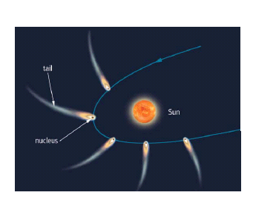
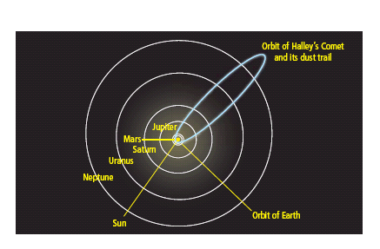
Comet Movement
PAGES 406-407

Slide 20
Comet Periodicity
Periodicity – the time taken for a comet to orbit the sun; i.e. how often we see a comet.
Period related to origin and composition!!
Halley’s comet was first comet whose return was predicted. Has a period of 76 years and will next be seen in 2061.
http://www.youtube.com/watch?v=EvhJgAOky-E

Slide 21
Asteroids, Meteors, Meteorites
Asteroids
One of many small rocky bodies in our solar system, most of which orbit the Sun between Mars and Jupiter.
They have orbits similar to the planets.
Some asteroids have irregular orbits due to gravitational attraction of the planets and collisions.
http://www.youtube.com/watch?v=PENT_hnyO-o

Slide 22
Asteroids, Meteors, Meteorites, cont’d
Meteoroids – pieces of rock floating through space
Meteors
meteoroids that burn up as they enter the Earth’s atmosphere
Shooting stars
Meteorites
Meteors that are large enough to survive passing through the atmosphere and subsequently reach Earth’s surface.
http://www.youtube.com/watch?v=6qVw1nILDBc

Slide 23
Impact Sites
The place where a relatively small object (meteorite) has collided with a larger object (planet) to produce a fairly circular depression on the surface of the larger object.
The size of the depression, or crater, created is often much larger than the object involved in the collision.
http://www.zmescience.com/other/great-pics/of-the-most-impressive-asteroid-impact-sites/
http://www.youtube.com/watch?v=Rd2IceT9PmU

Slide 24
The Sun’s effect on Earth
the sun influences almost all natural phenomena on Earth. From being the source of energy for green plants to impacting upon our communication systems, the sun’s influence is ever present.

Slide 25
The Sun’s effect on Earth, cont’d
Solar Radiation
Energy emitted from the Sun in the form of electromagnetic radiation
Grade 8 Flashback: Electromagnetic radiation energy that is carried in the form of waves that range in length from short to long (Ex. X-rays, UV rays,visible light, etc.)

Slide 26
11.3 The Exploration of Space

Slide 27
Technology of Space Travel
Rockets
A system used for transporting materials and astronauts into space.
Mostly contains explosive fuels that combine to create thrust; very similar to blowing up a balloon and releasing it.
As fuel is used up, parts of the propulsion system are released to make it lighter.

Slide 28
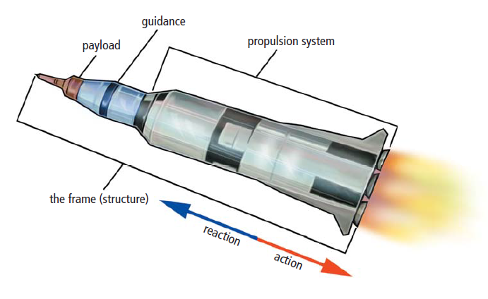
Technology of Space Travel
Rockets

Slide 29
Parts of a Rocket
Rockets
Frame: Payload, Guidance and Propulsion
Payload: The cargo that the rocket carries such as astronauts, satellites and other materials.
Guidance: Computers that guide the rockets direction
Propulsion: System that produces thrust.

Slide 30
Tech of Space Travel, cont’d
Space Shuttle
Differs from a rocket in that it is reusable; the only part discarded is the fuel tank.
Purpose:
Launching and retrieving satellites.
Delivering astronauts, supplies, and equipment t the International Space Station.

Slide 31
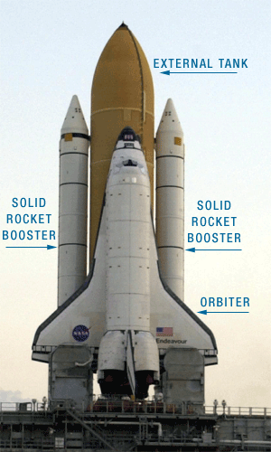
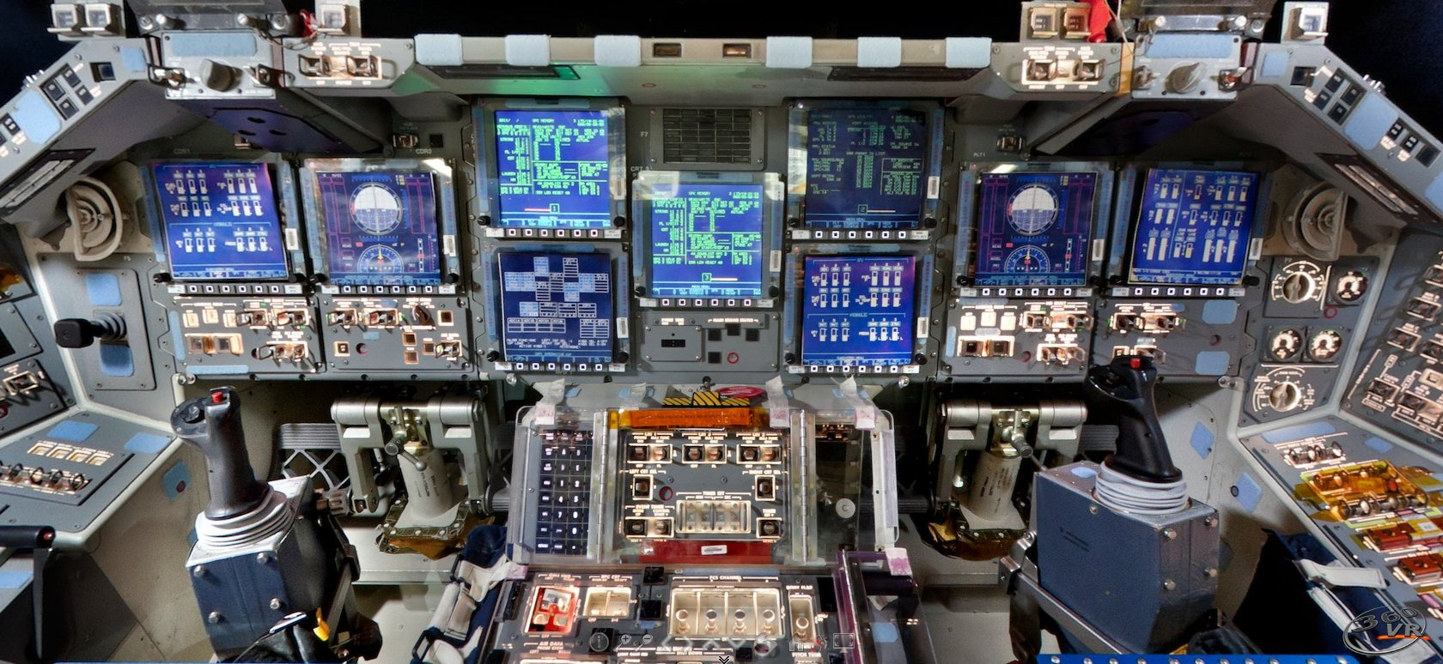
Technology of Space Travel
Space Shuttle

Slide 32
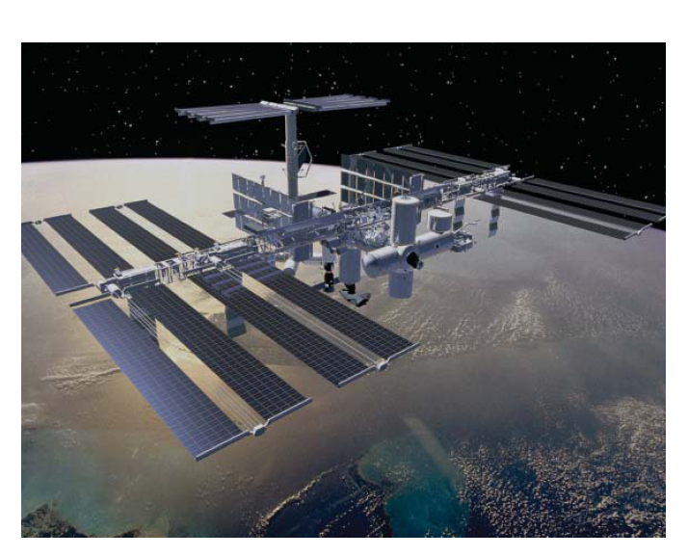
International Space Station

Slide 33
International Space Station
Construction began 1998
16 countries involved including Canada
Space-based laboratory
Orbits 350kms above Earth (just about the distance between here and Churchill Falls).
Travels at 27 000 km/hr; can circle the Earth in 90 minutes!
Lifetime of the ISS is expected to be 30 years.

Slide 34
ISS, cont’d
Scientists at the Canadian Space Agency are known around the world for their work in microgravity research.
Microgravity environment
Very weak gravity; less than 1 millionth of that on Earth.

Slide 35
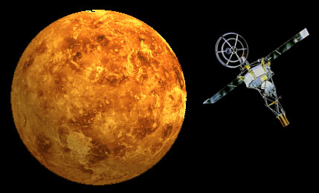
Space Travel
First things to be launched into space were probes:
Space vehicles carrying
scientific instrument and
sent to fly past, orbit, or
land on a celestial body to
collect data
Mariner orbiting Venus:
Next were the animals, followed by humans.
A July 2, 1959, Soviet launch carried two dogs and the first rabbit into space. The Soviet Sputnik 5 (Aug. 19, 1960) was the first to return animals alive from orbit. The passengers were the dogs Belka and Strelka, plus a gray rabbit, 42 mice, two rats and fruit flies

Slide 36
Space Travel Cont’d
The Moon then became the focus of attention.
In 1969, the US landed the first two people on the Moon
Neil Armstrong
Edwin “Buzz” Aldrin

Slide 37
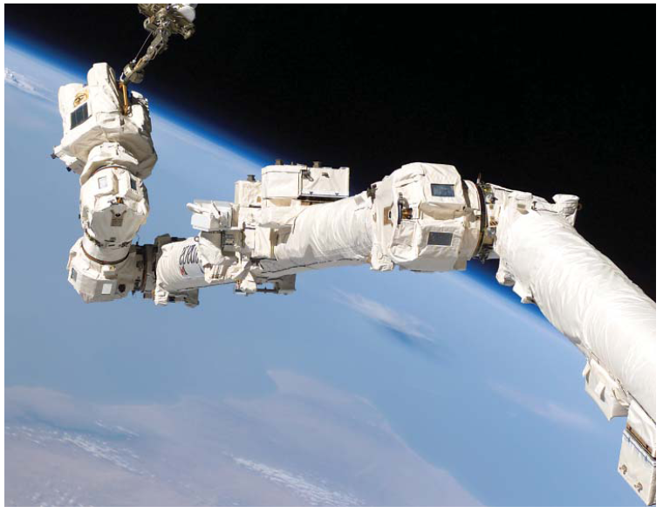
Canadian Contributions to Space Exploration
Canadarm 1
A Canadian designed and built a robotic arm to retrieve and launch satellites and to provide a stable platform for astronauts

Slide 38
Canadian contributions to space exploration, cont’d
Canadarm 2
Designed for ISS
Can do everything that Canadarm 1 can but is larger and can move independently (by itself).
Has a two-armed, robotic manipulator attached to its end name Dextre.

Slide 39
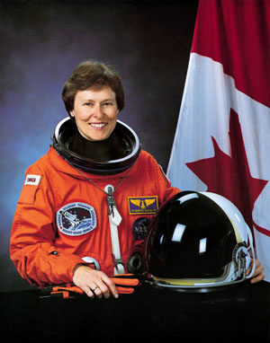
Canadian Astronauts
Roberta Bondar:
First Canadian female in space
(Jan 22-30, 1992) on the
Space Shuttle Discovery
One of 6 Canadian Astronauts
who trained in NASA in 1983
Researched the body’s reaction
to being in space.

Slide 40
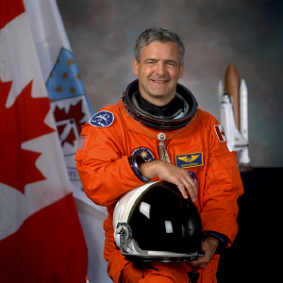
Canadian Astronauts
Marc Garneau:
First Canadian in space
(Oct 5-13, 1984) on the
Space Shuttle Challenger
President of the CSA
from 2001 to 2006
Current Minister of Transport with Govt of Canada

Slide 41
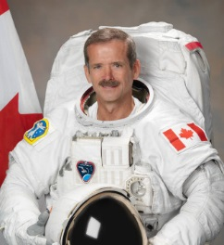
Canadian Astronauts
Chris Hadfield:
First Canadian to walk
in space (2001)
First Canadian to
command the ISS
(Dec 2012 to May 2013.
First Astronaut to operate
the Canadarm

Slide 42
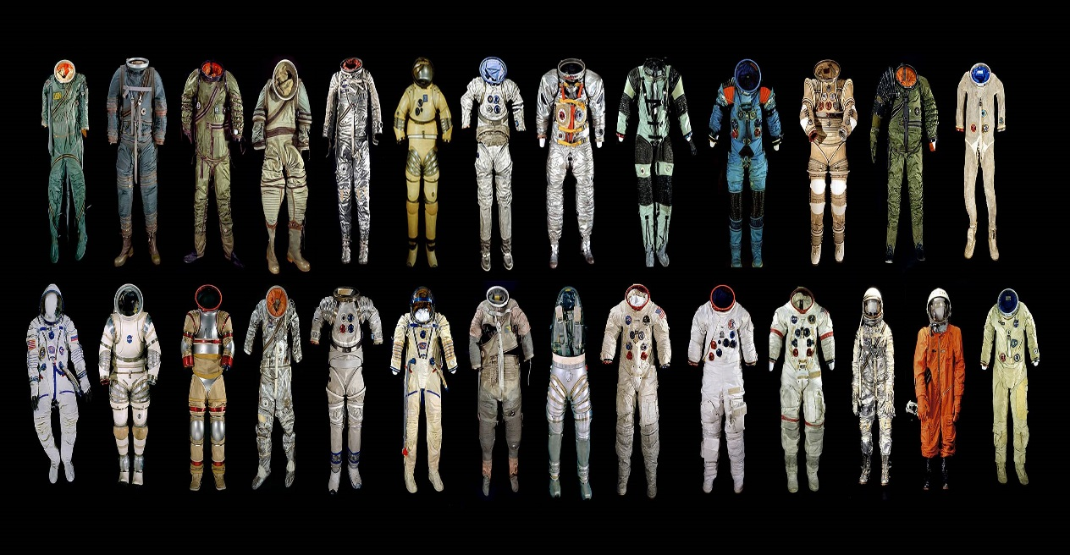
Space Exploration Technologies
Space Suits
Astronauts would quickly die if they ventured out into space without protection
The space suit acts
as mini-spaceship.
It has:
Oxygen to breath
A cooling system
A comunication system
A system to control air pressure

Slide 43
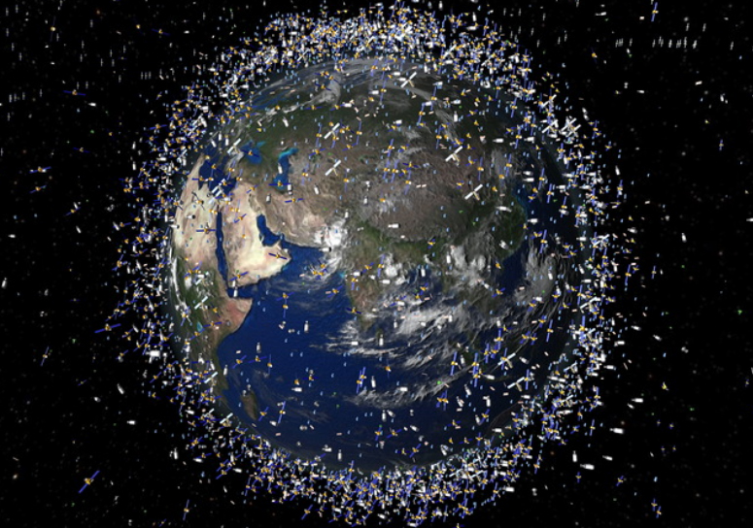
Space Exploration Technologies, cont’d
Orbiting Satellites

Slide 44
Space Exploration Technologies, cont’d
Orbiting Satellites
‘satellite’ means any body that orbits around another body in space; i.e. the moon is Earth’s natural satellite
An artificial satellite is an electronic device put in orbit around Earth to relay information.
http://www.seos-project.eu/modules/remotesensing/remotesensing-c02-p01.html

Slide 45
Space Exploration Technologies, cont’d
Orbiting Satellites, cont’d
Geosynchronous orbit
A satellite placed 36000km above the Earth takes 24h to orbit it. The Earth also rotates once in 24h so the satellite appears to sit above the same place on Earth.
Communication satellites (television/internet) are placed in this orbit.

Slide 46
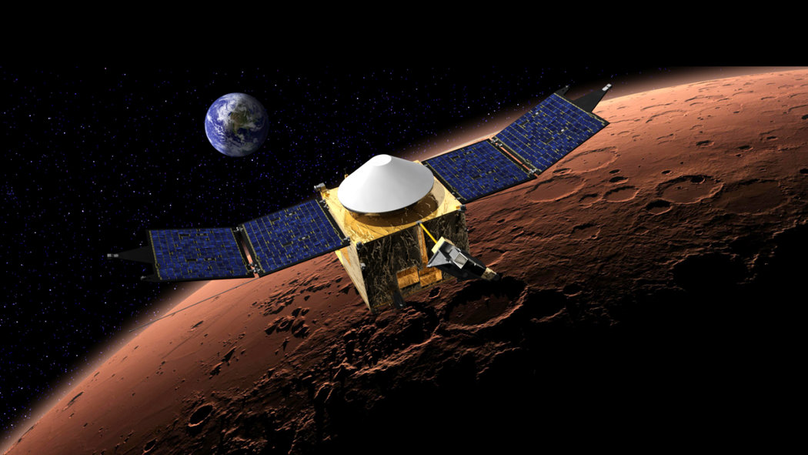
Space Exploration Technologies, cont’d
Probes

Slide 47
Space Exploration Technologies, cont’d
Probes
A space vehicle sent to other celestial bodies that carries scientific instruments.
They may fly past, orbit or land on a planet, moon, comet, or asteroid sending back information about its atmosphere and surface features.

Slide 48
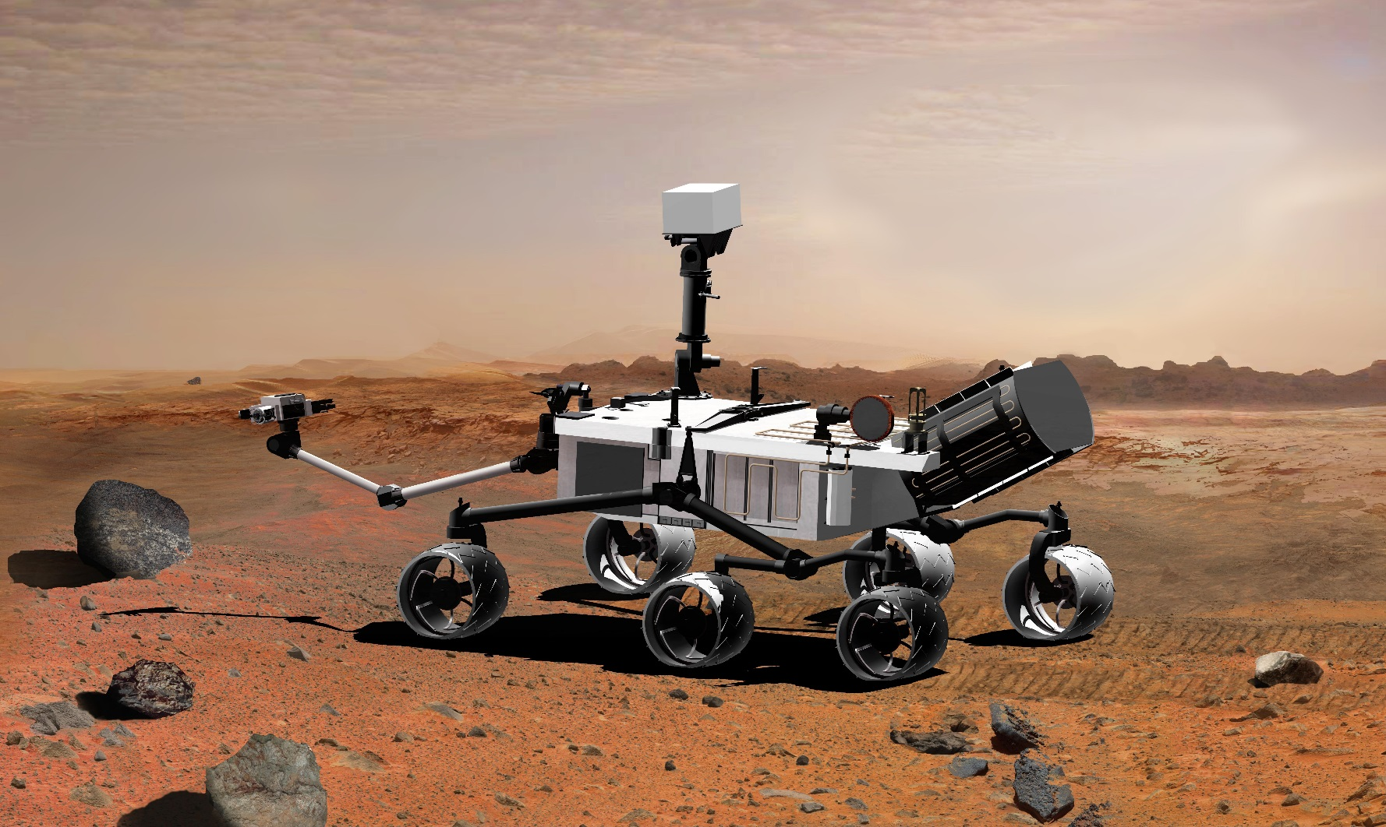
Space Exploration Technologies, cont’d
Rovers

Slide 49
Space Exploration Technologies, cont’d
Rovers
small, sophisticated, robotic probes designed to land on a planet, explore and test the surface, and send information back to Earth.
Sent to explore distant planets as it isn’t very safe or cost efficient to send humans.
Programmed to solve problem on their own due to the length of time to send radio signals back to Earth.

Slide 50
Space Exploration Technologies, cont’d
Rovers, cont’d
Work all day; pause at night to conserve battery
Explore hostile environments from the freezing surface of Mars to the furnace-like surface of Venus.

Slide 51
Space Exploration Technologies, cont’d
Optical Telescopes:
2 types:
1) Refracting – use lenses to gather and focus light to provide a magnified view.
2) Reflecting – use a series of mirrors to collect light and project the image into an eyepiece lens for the viewer.
Some conditions make observing difficult including cloudy weather and pollution.

Slide 52
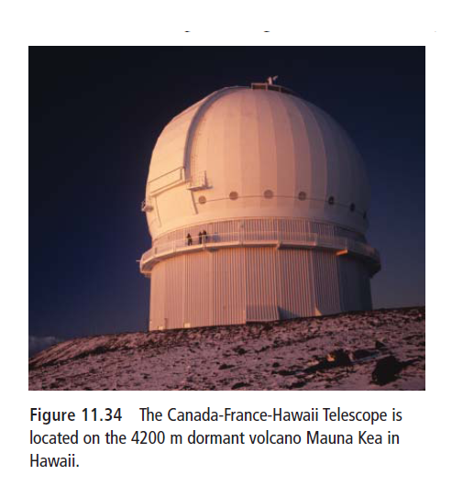
Space Exploration Technologies, cont’d
Optical Telescopes cont’d
Large observatories are placed on top of mountains giving a clearer view and providing cloud-free skies.

Slide 53
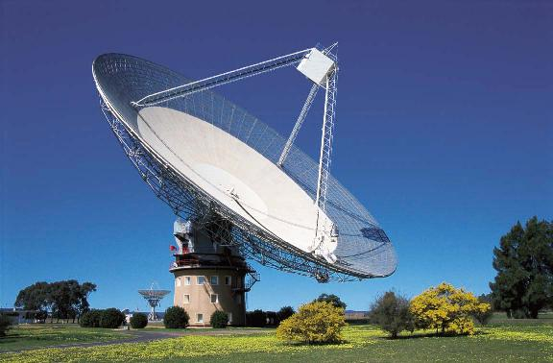
Space Exploration Technologies, cont’d
Radio Telescopes
Large receivers,
similar to satellite
dishes; radio signals
coming from a
distant object are
collected and focussed on a receiver These signals are converted into electric impulses that are then interpreted as data.

