Slide 1
Unit 1: Space Exploration
Chapters 10-12

Slide 2
Celestial Bodies
Definition:
A natural object out in space such as a planet, a moon, an asteroid, a comet, or a star.

Slide 3
Constellations
Constellations
A distinctive pattern in the night sky formed by a group of stars.
Asterisms
Smaller groups of stars forming patterns within the constellations.
Ex. Ursa Major contains the Big Dipper

Slide 4
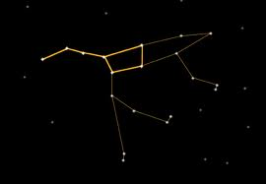
Big Dipper within Ursa Major

Slide 5
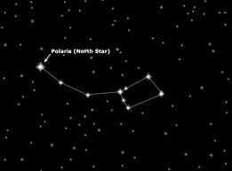
Ursa Minor aka Little Dipper

Slide 6
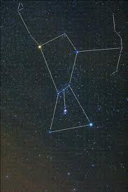
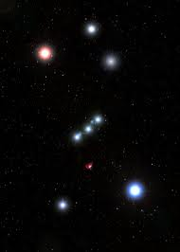
Orion
Orion’s Belt

Slide 7
The movement of celestial bodies
Why do stars appear to move?
Looking North, stars seem to move clockwise around the North Star (Polaris); looking south, stars appear to move from East to West.
This is because of Earth’s movement. It moves in two ways:
Spinning on its axis.
Rotating around the Sun.

Slide 8
The movement of celestial bodies
Why does the moon appear to move?
The moon orbits the Earth from West to East. This occurs because of the rotation of the Earth on its axis.

Slide 9
The movement of celestial bodies
Why does the Sun appear to move?
The sun appears to move in the sky due only to the rotation of the Earth on its axis.
https://www.youtube.com/watch?v=W47Wa7onrIQ

Slide 10
The movement of celestial bodies
Why do the planets appear to move?
The planets orbit the sun at different rates. It appears as though the Mercury and Venus are racing compared to the slower outer planets.
https://www.youtube.com/watch?v=z8aBZZnv6y8

Slide 11
The movement of celestial bodies
Why do the comets and asteroids appear to move?
Asteroids orbit between Mars and Jupiter.
Comets orbit the Sun.
https://www.youtube.com/watch?v=azeKtpoS8Vw
https://www.youtube.com/watch?v=EvhJgAOky-E

Slide 12
The movement of celestial bodies
celestial bodies move in cyclic paths called orbits and these orbits result from gravitational forces.
planets, suns, and moons revolve on a central axis
(Imagine: spinning a basketball on your finger and walking a circle around your friend the room in an orbit. This represents celestial bodies rotating around a central axis while orbiting other celestial bodies.)

Slide 13
Constructing Constellations
Worksheet:

Slide 14
10.2 Early Models of the Universe
Scientific Contributions

Slide 15
Aristotle (383-322 B.C.E)
Visualized a geocentric universe.
Geocentric universe - the earth is the centre of the universe with sun, moon, stars and other planets moving around it.
He observed shadows on the moon during a lunar eclipse and concluded that, since those shadows had curved edges, Earth must be spherical.
He also observed that as you travel north or south, different constellations come into view.
https://www.youtube.com/watch?v=BeJJpbDrVRM

Slide 16
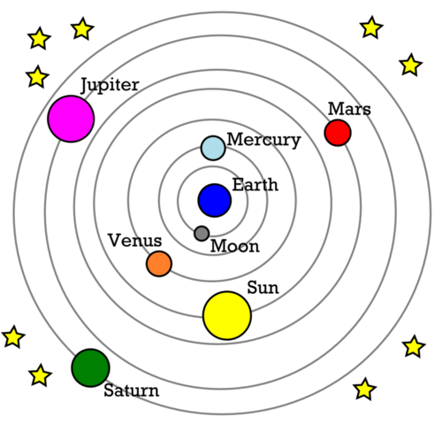
Aristotle (383-322 B.C.E)

Slide 17
Eratosthenes (276-194 B.C.E)
* Was the first scientist to accurately measure the circumference of the Earth using 2 sticks and some basic mathematics.
https://www.youtube.com/watch?v=wnElDaV4esg&list=PL7BB1BADE1022002F
* Developed an algorithm to determine all prime numbers up to a given limit.

Slide 18
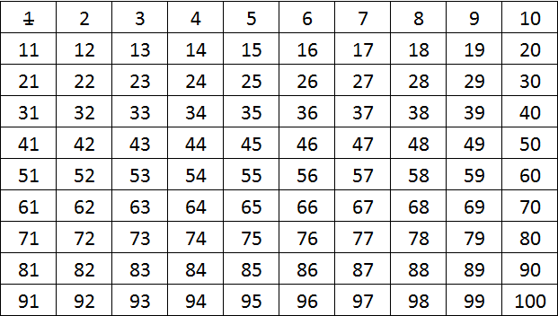
Sieve of Eratosthenes

Slide 19
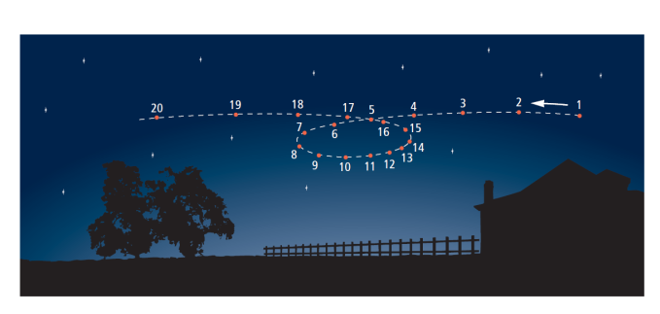
Ptolemy (83-168 C.E)
Retrograde motion
an apparent switch in the motion of a celestial body from eastward to westward or vice versa, as seen from earth.

Slide 20
Ptolemy (83-168 C.E)
Epicycle: Point in space Ptolemy proposed all planets revolved around.
Astrolabe
An ancient instrument used to locate and predict the positions of the sun, moon, planets, and stars.
https://www.youtube.com/watch?v=EpSy0Lkm3zM

Slide 21
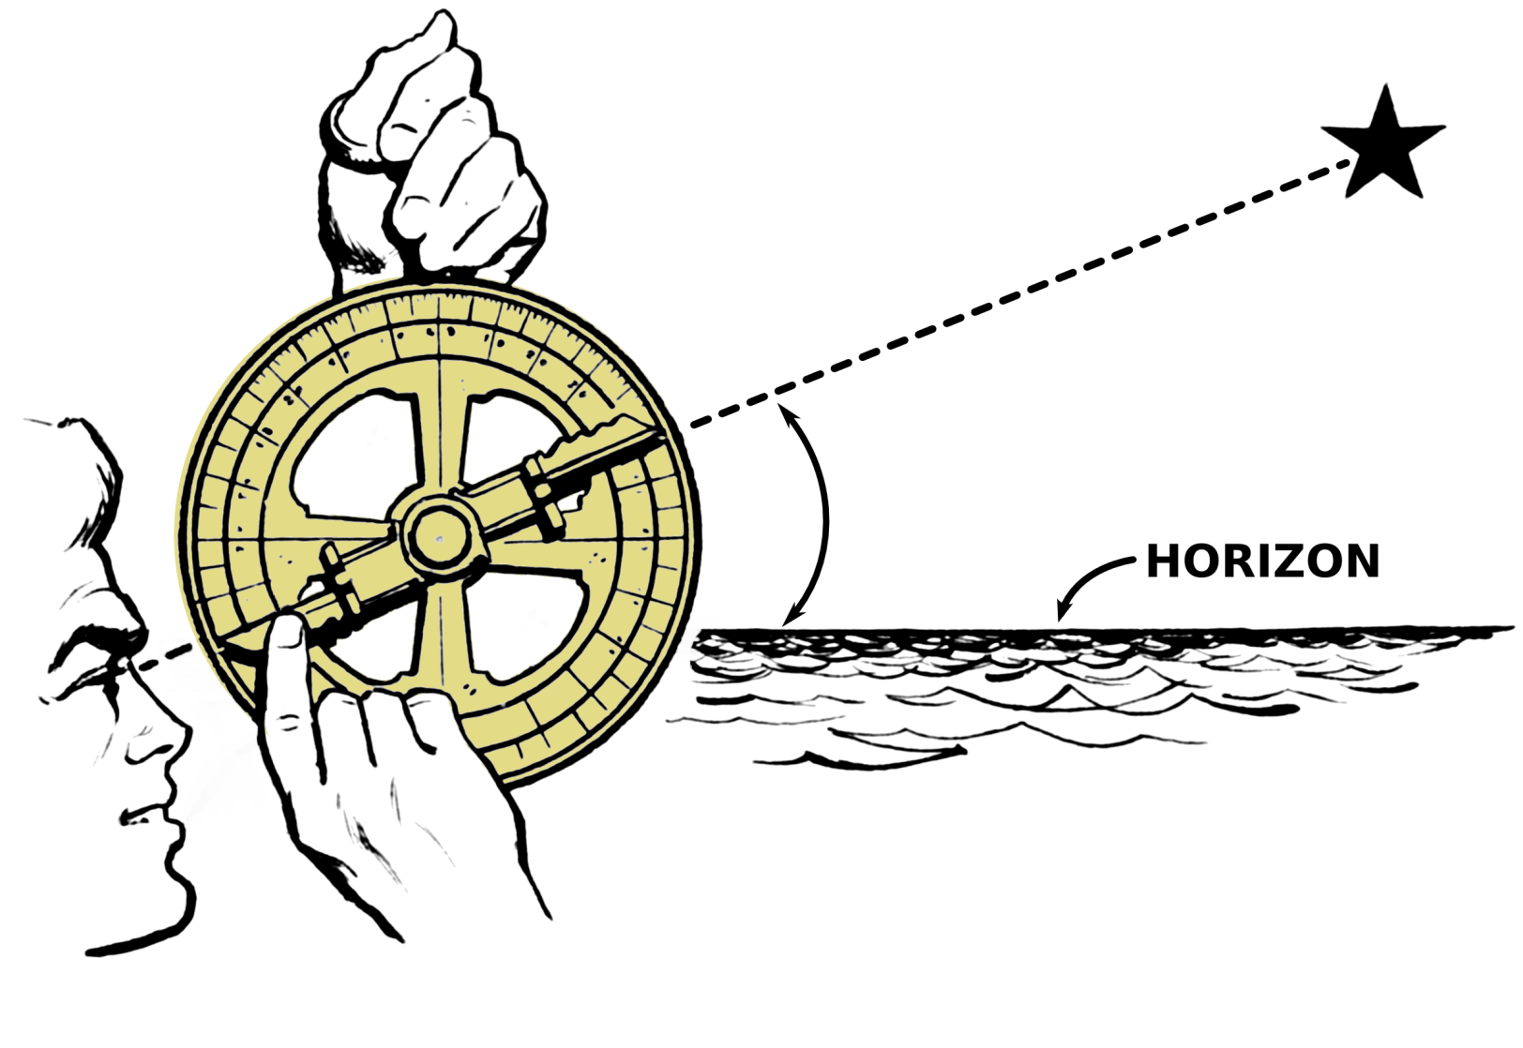
Astrolabe

Slide 22
Copernicus (1473-1543)
Earth rotated on its axis once daily and revolved around the Sun once a year.
Heliocentric universe – sun as centre of universe
https://www.youtube.com/watch?v=8fbCIQK977Y
(Fun fact: Fellow scientist Giordano Bruno agreed with this model and suggested the existence of more suns with planets and possible inhabitants which may be superior to mankind. He went on trial for this idea, was found guilty and was burned at stake.)

Slide 23
Copernicus (1473-1543)

Slide 24
Galileo (1564-1642)
First to use a telescope (only 20x magnification) to view celestial bodies
Galileo used a careful scientific methodology and applied it to astronomy for the first time. He observed that Venus has phases like our Moon proving the heliocentric model.
https://www.youtube.com/watch?v=-QUegBP3qwg
(Fun fact: Because he published this information which contradicted the theories of the catholic church, Galileo was imprisoned for the remainder of his life.)

Slide 25
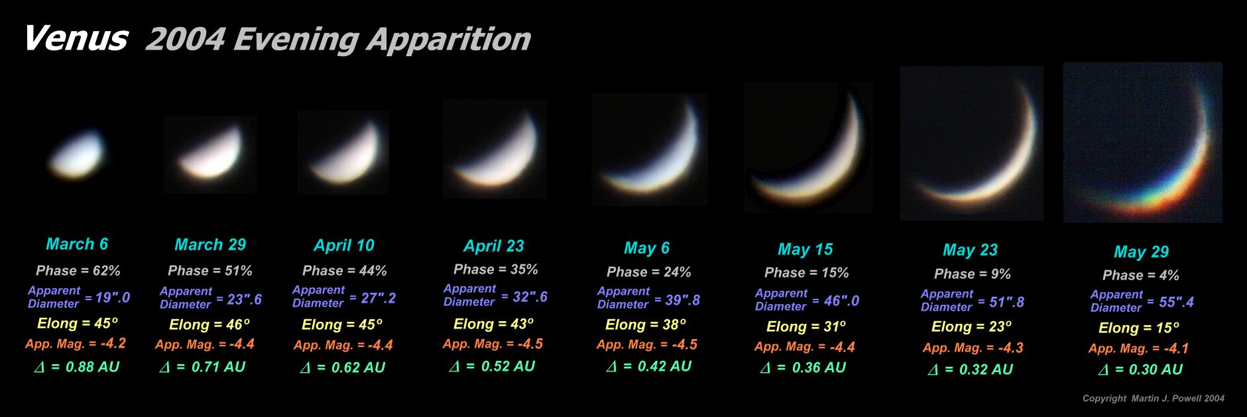
Galileo (1564-1642)

Slide 26
10.3 Standing on the Shoulders of Giants
Scientific Contributions

Slide 27
Kepler (1571-1630)
Kepler determined that planets follow an elliptical path.
Developed the three laws of planetary motion.

Slide 28
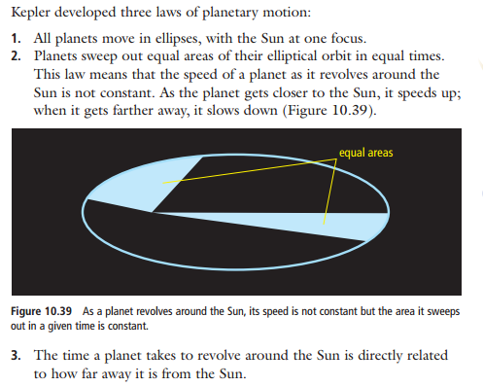
Kepler (1571-1630)

Slide 29
Tycho Brahe (1546-1601)
A Danish noblemen who used calculations by observing the positions of the planets.
Provided Kepler with data to create the three laws of planetary motion.
https://www.youtube.com/watch?v=x3ALuycrCwI

Slide 30
Sir Isaac Newton (1643-1727)
Related gravity to celestial bodies causing them to remain within orbit .
We now use his laws when calculating how to send spacecraft to the moon and planets.
Invented reflecting telescope
Created a branch of mathematics called Calculus.
Grade 8 flashback: Newton also discovered the refraction of white light into its color spectrum through a prism and he invented the reflecting telescope
https://www.youtube.com/watch?v=wAYrfrjNPhM.

Slide 31
Technological advancement
Early technologies advanced scientific observations about the solar system.
Include
Stone Circles
Astrolabe
Early telescope

Slide 32
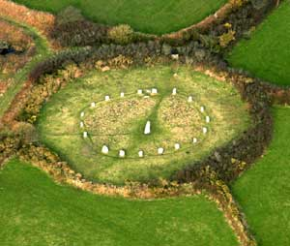
Stone Circles

Slide 33
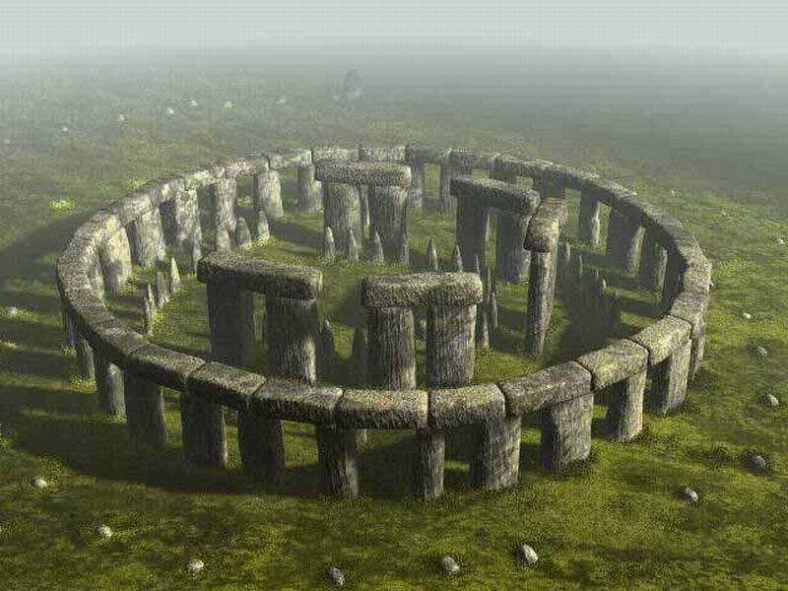
Stone Circles

Slide 34
Technological advancement
Astrolabe: A device used by astronomers, navigators, and astrologers to predict the positions of celestial bodies.

Slide 35
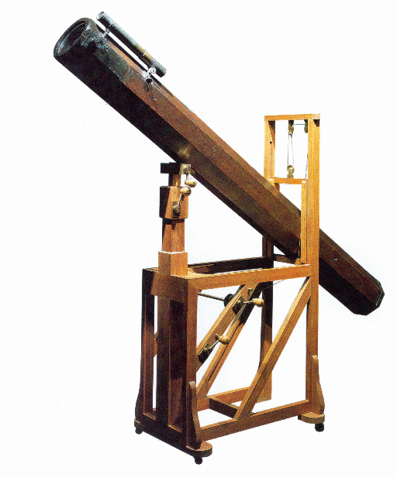
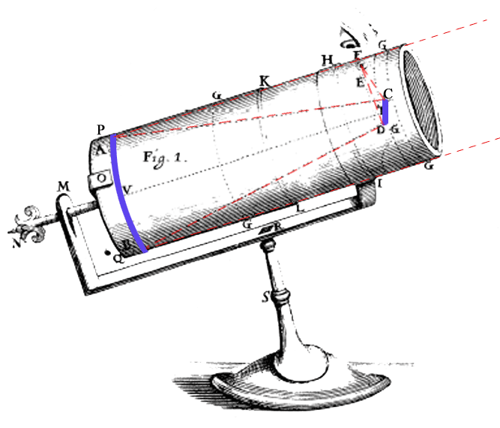
Technological advancement
Early telescopes

Slide 36
Questions
Pg 386 – 387
Questions 1, 2, 6, 7, 8, 11, and 17

Slide 37
CORE LAB #1
10-3B Strolling Through the Solar System

