Slide 1
Chapter 9:
Circuits are designed to control the transfer of electrical charge

Slide 2
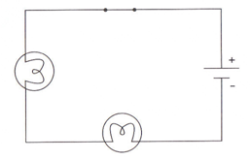
Section 9.1: Series and Parallel Circuits:
Series Circuits:
A circuit that has only one path for electrical current to flow. It does not contain any branches
If one of the loads from the circuit is removed or is broken then the circuit gets broken resulting in no electricity flow. “One light goes, they all go”
Example: Some Christmas Tree lights

Slide 3
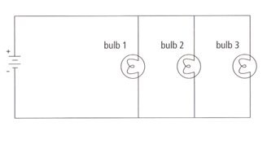
Parallel Circuit
A circuit that has two or more different paths for the electrical current to flow.
If one device is removed or broken then there is still another path for the electrical current to flow.
Example: Lighting in a house

Slide 4
Comparing Series and Parallel Circuits
 | Series | Parallel
Number of paths | One | Several
Effect of removing a load | Electrons cannot flow | Electrons continue to flow
Resistance | The total resistance increases when loads are added in series | The total resistance of the circuit is decreased when loads are placed parallel
Current | Same throughout circuit | Current through the paths will change depending on the resistance in the path. Less resistance more current through it. Total current = sum of current through each path.

Slide 5
Parallel vs. Series Circuits
Useful website:
www.bbc.co.uk/schools/scienceclips/ages/10_11/changing_circuits_fs.shtml

Slide 6
Voltage and Current in a Series Circuit
Cells in series:
the effective voltage is the sum of the voltages of each cell.
All voltage provided by the source is lost.
The life of the battery is equal to the life of one of the cells.
Current in series:
Electrons remain evenly spaced apart.
There is only one route to follow so the current in each part of the circuit is the same everywhere in the circuit.

Slide 7
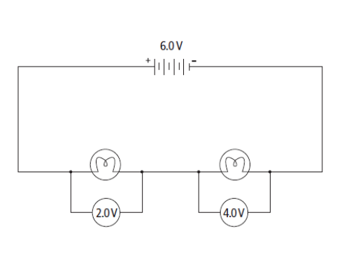
Voltage and Current in a Series Circuit

Slide 8
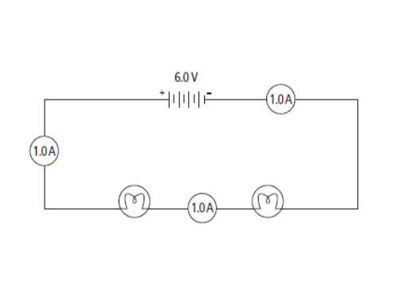
Voltage and Current in a Series Circuit

Slide 9
Voltage and Current in a Parallel Circuit.
Cells in Parallel:
The effective voltage is the same as the voltage of a single cell
The life of the battery is the sum of the life of each cell (battery lasts longer)
Current in Parallel:
There are many paths for the electrons to take so the current at different points in the circuit is not even. Usually the electrons will follow the path with the least resistance. The part at which there is a “fork in the road” is called a junction point.
Note: the total current entering a junction point equals the current in each branch.

Slide 10
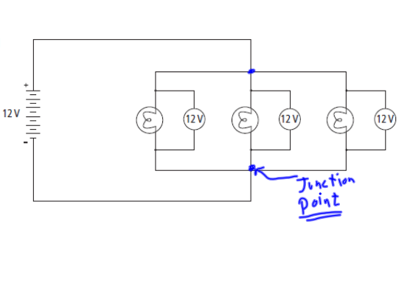
Voltage and Current in a Parallel Circuit

Slide 11
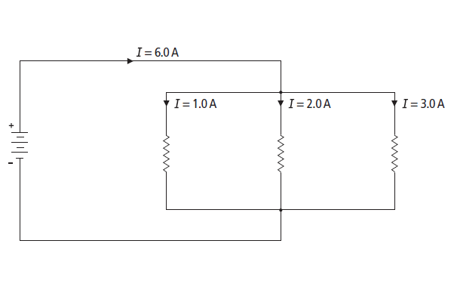
Voltage and Current in a Parallel Circuit

Slide 12
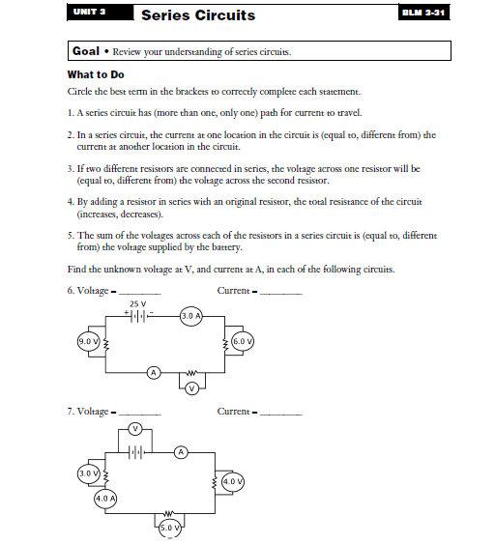
Series Circuit Review

Slide 13
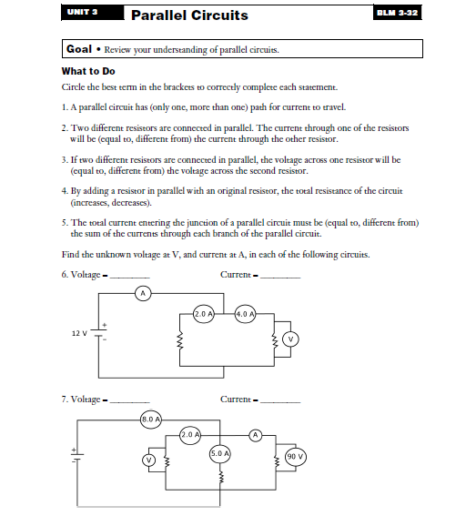
Parallel Circuit Review

Slide 14
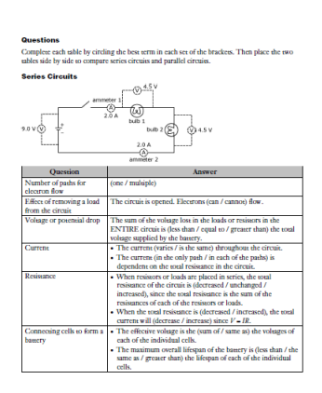
Series Circuit Review

Slide 15
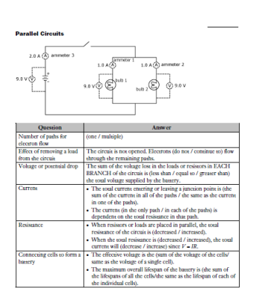
Parallel Circuit Review

Slide 16
Uses for Series and Parallel connection of cells
Flashlight: cells are connected in series. The higher voltage means a larger current provided to the bulb making it brighter
Lighthouse: Cells are connected in parallel. The lights are much dimmer but the battery would last longer.

Slide 17
Technologies
Circuit Breaker:
a safety device in an electrical circuit; acts as a switch to cut off power to a circuit if the current exceeds a safe level.
The circuit breaker will ‘trip’. This is caused by a bi-metallic strip bending and opening the circuit, stopping the flow of electricity. The circuit can be closed once the breaker cools and can be reset.

Slide 18
Technologies
2. Fuse:
a protective mechanism in an electrical circuit; contains a metallic conductor that will melt if too much current passes through it, thus opening the circuit.
Circuit breakers and fuses work to ensure that the current in a circuit does not reach a level where the wires would get hot and start a fire in your home

Slide 19
Technologies
3. Grounding terminals:
The round prong of an electrical plug; allows excess current to flow from an electrical device to the ground to prevent electrical shock.

Slide 20
Section 9.2: Energy and Power
Joule (J): the unit Electrical Energy: the ability to do work by pushing electrons around a circuit
for measuring energy
Electrical Power: the rate of change in electrical energy (rate at which work is done)
Watt (W): a unit of power; one watt is one joule of energy transformed in one second (J/s).
Example: a 60 W light bulb uses 60 J of electrical energy every second and produces 60 J of heat and light

Slide 21
Energy Use
Power consumption is directly related to voltage, electrical current and time
The higher the current and voltage and the longer the device is operated, the greater the power consumption. As a result, the more money it costs to operate.
Example 1: Electric stoves and driers operate on greater voltage (220v) and current than other devices so it costs more to operate
Example 2: A toaster and radio both operate using the same voltage (11ov) but current is more in the toaster so it costs more to operate.

Slide 22
Calculating Power
P
What is the power output of a 9.0 V battery if it supplies a current of 3.0 A?
A 80 W light bulb is connected to 120 V battery. What current passes through the light bulb?

Slide 23
Calculating Power
A voltmeter measures 8 V across a 32 W resistor. What current is passing through the resistor?
A circuit draws a current of 50mA from a 16 V battery. What is the power output of this battery?

Slide 24
Calculating Power
A 0.40 A current passes through a 600 Ω resistor. Calculate the power ‘lost’ in this resistor. (Use Ohm’s Law to first find the voltage)

Slide 25
Calculating Energy Consumption
Power Rating: a measurement of how much electrical energy an electrical device uses for every second it is in use.
Using the power rating and the amount of time something is being used, you can find the amount of electrical energy a particular item uses.
P = E
t
P is power, E is the energy transferred and t is the time
E
P
t

Slide 26
Calculating energy consumption
How much electrical energy is consumed by a 1200W hair dryer if it is used for 5 minutes?

Slide 27
Calculating energy consumption
How much energy, in joules, is consumed by a 400 W stereo if it is left on for 3 h?

Slide 28
Practice Problems
Page 308
1-3

Slide 29
Energy Consumption
Household electrical energy consumption is often expressed as kWh (kilowatt-hour)
More convenient because a lot of energy in consumed in an average house in any given day
Note 1 kilowatt (kW) = 1000 Watts (W)
Energy labels on appliances are in kW·h rather than joules

Slide 30
The Price of Energy
A meter reader determines that a business has used 4800 kW*h of energy in three months. If electricity costs 12 cents per kW*h, calculate the bill.

Slide 31
The Price of Energy
An electrical heater draws 1500 W of power. Electricity costs 7 cents per kW*h. How much does it cost to operate the heater for 5 hours a day for 30 days?

Slide 32
The Price of Energy
A 840 W toaster and 1700 W kettle are plugged into the same 100 V outlet. How much will it cost to operate the two appliances at 9 cents per kW*h if they are used for 18 hours?

Slide 33
The Price of Energy
A breakfast sandwich maker is used an average of 10 h a month. The device draws 12 A of current from a 110 V outlet. If electricity costs 6 cents per kW*h. how much will it cost to operate the sandwich maker for one year?

Slide 34
Section 9.3: Electrical Energy in the Home
Not all electrical energy used to make a stove element hot is transferred to the water in a pot
Some of the energy is converted to heat energy, some is converted to light energy (red element), or sound energy (element making a cracking or popping sound as it expands)

Slide 35
Energy Efficiency
Efficiency: the percentage of energy input that is converted to a useful form. Ex: what percent of the energy used in the stove is used to heat the water (the goal)
Traditional incandescent lighting is only about 5% efficient (only 5 % of the energy is converted to light energy)
Fluorescent lighting is about 3 to 4 times more efficient (15% to 20%) at converting electrical energy to light energy.

Slide 36
Calculating Efficiency
Efficiency =
Energy input: all of the electric energy the device took in
Energy Output: energy converted to a useful form by the device

Slide 37
Calculating Efficiency, cont’d
Incandescent lightbulbs:
Left on for 10.0h/week uses 7.0kWh of energy to supply 0.4kWh of light.
Fluorescent lightbulbs:
Left on for 10.0h/week uses 2.0kWh of energy to supply 0.4kWh of light.
Which lightbulb is more energy efficient?

Slide 38
Calculating Efficiency, cont’d
1. How efficient is a 60 W incandescent light bulb that produces 2200 J of light from 27 500 J of electrical energy?
2. How efficient is a fluorescent light bulb that uses 5.6 kJ of electrical energy and produces 1400 J of light energy?

Slide 39
Calculating Efficiency, cont’d
3. How efficient is an electric motor that uses 48 kJ of electrical energy and produces 38.4 kJ of useful energy?
4. A kettle is designed to be 92.2% energy efficient. If the kettle uses 72 kJ of electricity to boil 500 mL of water, what is the amount of useful energy, and what the amount of wasted energy?

Slide 40
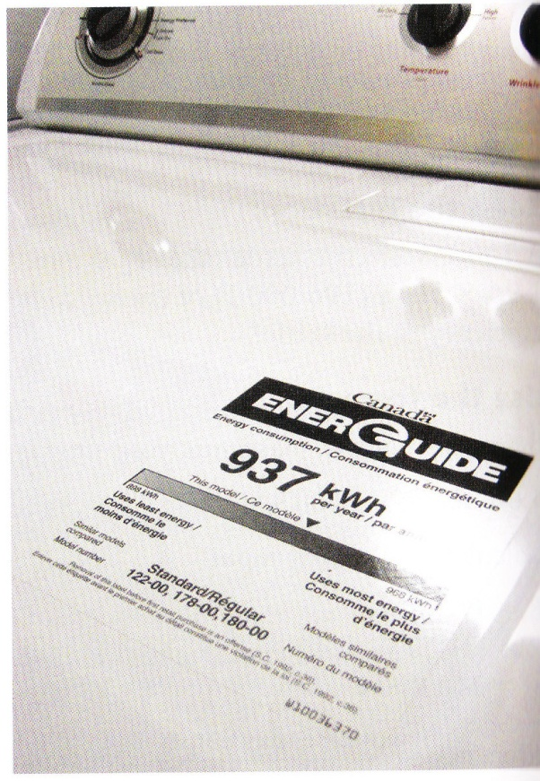
How to choose energy efficient appliances
EnerGuide Label: Label that is placed on an appliance to display how much energy the device typically uses in a year and compares its energy consumptions with other appliances in the same category.

Slide 41
Reducing the consumption of electrical energy
Improve insulation
Turn off lights when not required
Use energy efficient light bulbs
Air dry clothes when possible
Etc.

Slide 42
Section 9.4: Electricity and the Environment
Generator: a device that converts mechanical energy into electrical energy
Components of Generator:
Coil of wire that rotates inside a stationary magnet
Generators need an energy input such as falling water (mechanical energy) to move over a turbine
Turbine: a cylinder with blades and when water is pushed the blades turns the cylinder.
This also moves the coil of wire within the magnet of a generator, creating an electric current

Slide 43
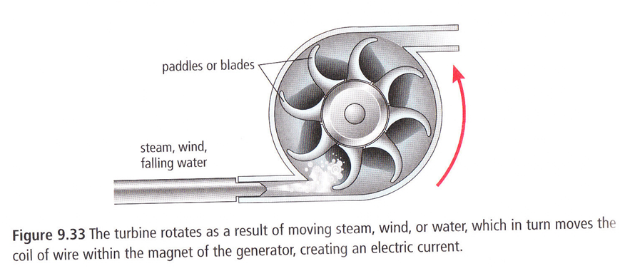
Turbine

Slide 44
Types of generating stations
Hydroelectric: uses the energy of falling or flowing water to spin a turbine.
Thermal generating station: uses heat (thermal energy) produced from the burning of fossil fuels to boil water. The resulting steam is used to spin a turbine
Nuclear generating station: uses the heat (thermal energy) released from a nuclear reaction to boil water. The resulting steam is used to spin the turbine

Slide 45
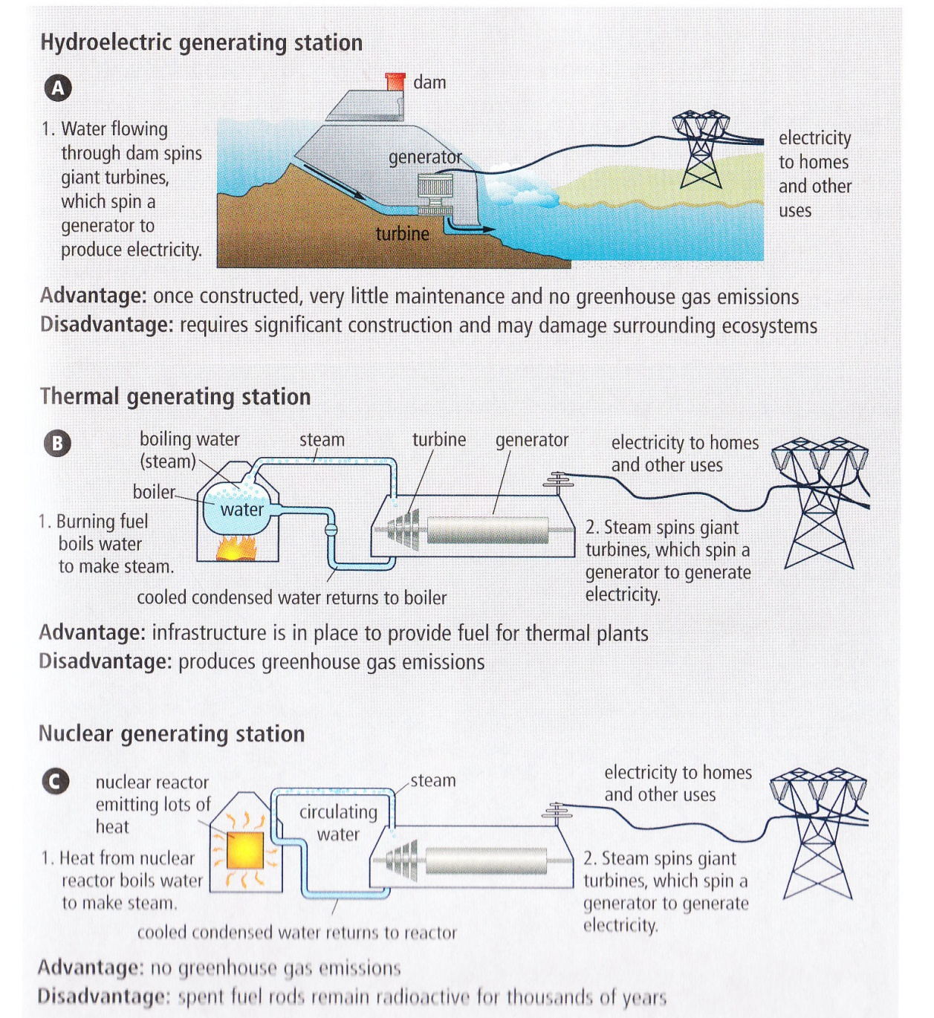
Generating stations

Slide 46
Transmission of Electrical Energy (901)
Electrical energy is transmitted over large distances.
Energy created at Churchill falls, travels through Quebec to customers far away on the East coast of North America.
Transformers are used to step up voltage before leaving the generating station
Transformers: a simple electrical device that changes voltage

Slide 47
Transmission …
Transformers are also used to step down voltage before it enters a house
Power adaptors are also transformers. They step down the voltage to the correct amount so that you can use your device (like a laptop computer)
Household use requires a voltage of 120 V and 240 V.
(902)

Slide 48
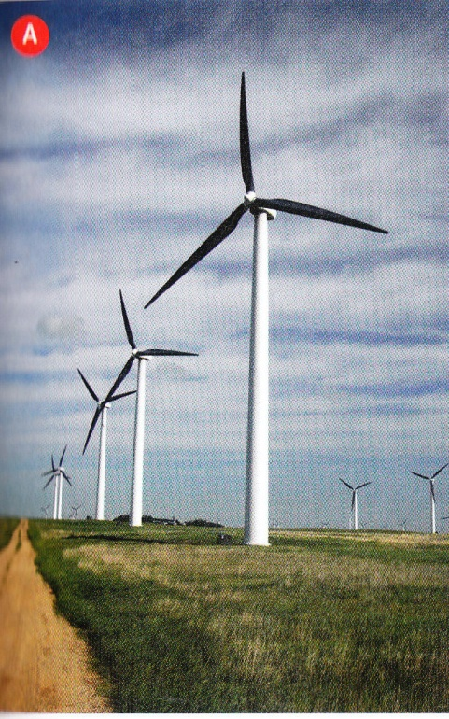
Alternative Sources of Electrical Energy
Wind Generator
Produces electrical energy using turbines
similar to those used in hydroelectric
power generation.
Can be set up in a “wind farm” that supplies
energy to an electric company or can be set up to
supply energy directly to an individual home or farm.

Slide 49
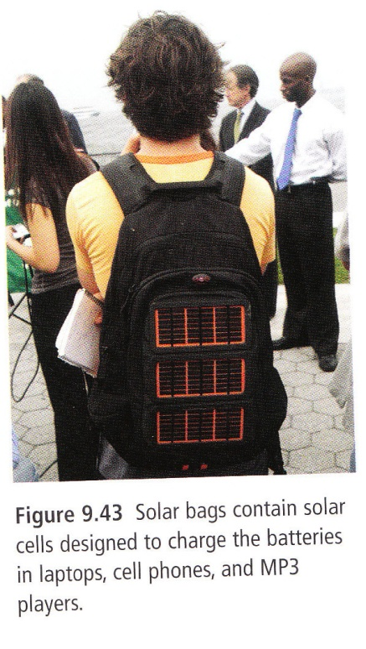
Alternative Sources of Electrical Energy
2) Solar energy
Solar cells convert sunlight into electrical
energy.
In Canada, the amount of sunlight available
is limited because we are so far north of the equator.
Fuel is free but relying on solar energy to provide electrical power for the typical home is unreasonable.

Slide 50
Alternative Sources of Electrical Energy
3) Fuel Cells
Like a battery in that it produces
an electric current using two
electrodes and an electrolyte.
Unlike a battery, a fuel cell’s
chemical components are not
consumed over time.
6 Types.

