Slide 1
Chapter 9:
Circuits are designed to control the transfer of electrical charge

Slide 2
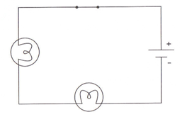
Section 9.1: Series and Parallel Circuits:
Series Circuits:
A circuit that has only one path for electrical current to flow. It does not contain any branches
If one of the loads from the circuit is removed or is broken then the circuit gets broken resulting in no electricity flow. “One light goes, they all go”
Example: Some Christmas Tree lights

Slide 3
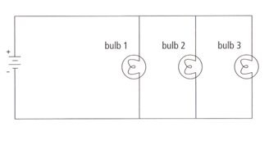
Parallel Circuit
A circuit that has two or more different paths for the electrical current to flow.
If one device is removed or broken then there is still another path for the electrical current to flow.
Example: Lighting in a house

Slide 4
Parallel vs. Series Circuits
Useful websites:
www.learningcircuits.co.uk/flashmain.htm
www.bbc.co.uk/schools/scienceclips/ages/10_11/changing_circuits_fs.shtml

Slide 5
Comparing Series and Parallel Circuits
 | Series | Parallel
Number of paths | One | Several
Effect of removing a load | Electrons cannot flow | Electrons continue to flow
Resistance | The total resistance increases when loads are added in series | The total resistance of the circuit is decreased when loads are placed parallel
Current | Same throughout circuit | Current through the paths will change depending on the resistance in the path. Less resistance more current through it. Total current = sum of current through each path.

Slide 6
Voltage and Current in a Series Circuit (902)
Cells in series:
the effective voltage is the sum of the voltages of each cell (more voltage supplied to device)
All voltage provided by the source is lost.
The life of the battery is equal to the life of one of the cells (battery dies quicker)
Current in series:
Electrons remain evenly spaced apart.
There is only one route to follow so the current in each part of the circuit is consistent.

Slide 7
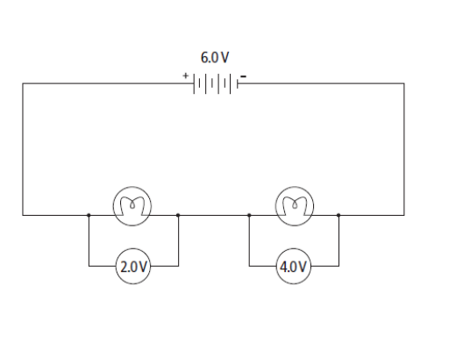
Voltage and Current in a Series Circuit

Slide 8
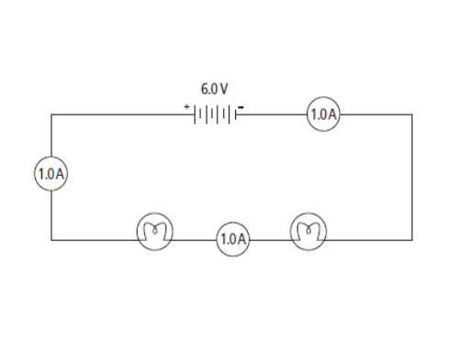
Voltage and Current in a Series Circuit

Slide 9
Voltage and Current in a Parallel Circuit (901)
Cells in Parallel:
The effective voltage is the same as the voltage of a single cell
The life of the battery is the sum of the life of each cell (battery lasts longer)
Current in Parallel:
There are many paths for the electrons to take so the current at different points in the circuit is not even. Usually the electrons will follow the path with the least resistance. The part at which there is a “fork in the road” is called a junction point.
Note: the total current entering a junction point equals the current in each branch.

Slide 10
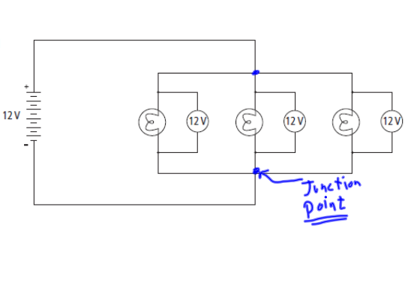
Voltage and Current in a Parallel Circuit

Slide 11
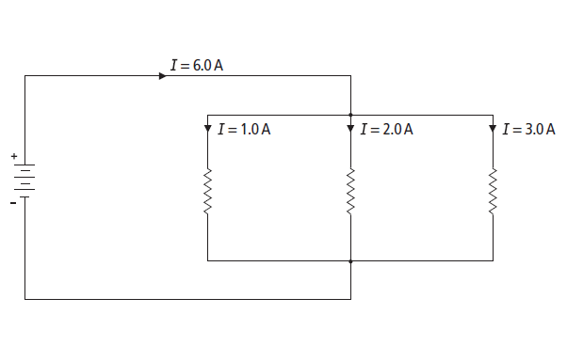
Voltage and Current in a Parallel Circuit

Slide 12
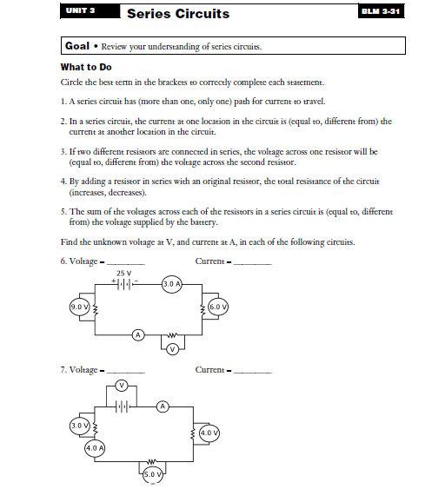
Series Circuit Review

Slide 13
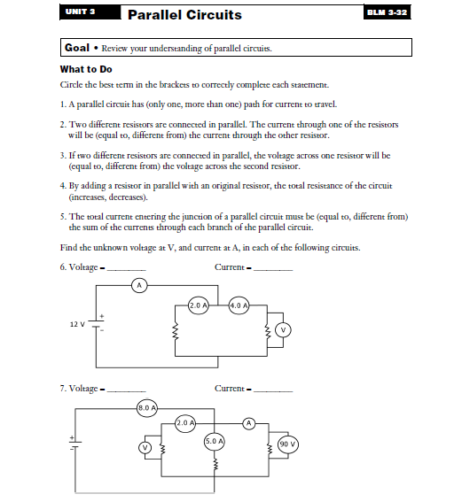
Parallel Circuit Review

Slide 14
Uses for Series and Parallel connection of cells
Flashlight: cells are connected in series. The higher voltage means a larger current provided to the bulb making it brighter
Lighthouse: Cells are connected in parallel. The lights are much dimmer but the battery would last longer.

Slide 15
Technologies
Circuit Breaker:
a safety device in an electrical circuit; acts as a switch to cut off power to a circuit if the current exceeds a safe level.
The circuit breaker will ‘trip’. This is caused by a bimetallic strip bending and opening the circuit, stopping the flow of electricity. The circuit can be closed once the breaker cools and can be reset.

Slide 16
Technologies
2. Fuse:
a protective mechanism in an electrical circuit; contains a metallic conductor that will melt if too much current passes through it, thus opening the circuit.
Circuit breakers and fuses work to ensure that the current in a circuit does not reach a level where the wires would get hot and start a fire in your home

Slide 17
Technologies
3. Grounding terminals:
The round prong of an electrical plug; allows excess current to flow from an electrical device to the ground to prevent electrical shock.

Slide 18
Section 9.2: Energy and Power
Electrical Energy: the ability to do work by pushing electrons around a circuit
Joule (J): the unit for measuring energy
Electrical Power: the rate of change in electrical energy (rate at which work is done)
Watt (W): a unit of power; one watt is one joule of energy transformed in one second (J/s).
Example: a 60 W light bulb uses 60 J of electrical energy every second and produces 60 J of heat and light

Slide 19
Energy Use
Power consumption is directly related to voltage, electrical current and time
The higher the current and voltage and the longer the device is operated, the greater the power consumption. As a result, the more money it costs to operate.
Example 1: Electric stoves and driers operate on greater voltage 220v and current than other devices so it costs more to operate
Example 2: A toaster and radio both operate using the same voltage (11ov) but current is more in the toaster so it costs more to operate.

Slide 20
Calculating Energy Consumption
Power Rating: a measurement of how much electrical energy an electrical device uses for every second it is in use.
Using the power rating and the amount of time something is being used, you can find the amount of electrical energy a particular item uses.
P = E
t
P is power, E is the energy transferred and t is the time
Practice Problems on page 308.
E
P
t

Slide 21
Calculating energy consumption
How much electrical energy is consumed by a 1200W hair dryer if it is used for 5 minutes?

Slide 22
Practice Problems
Page 308
1-3

Slide 23
Energy Consumption
Household electrical energy consumption is often expressed as kWh (kilowatt-hour)
More convenient because a lot of energy in consumed in an average house in any given day
1.0 kilowatt-hour = 1.0 kilowatt X 1.0 hour
Note 1 kilowatt (kW) = 1000 Watts (W)
Energy labels on appliances are in kW·h rather than joules

Slide 24
Task:
Find the energy consumption rating of a variety of appliances in your home like the one shown below

Slide 25
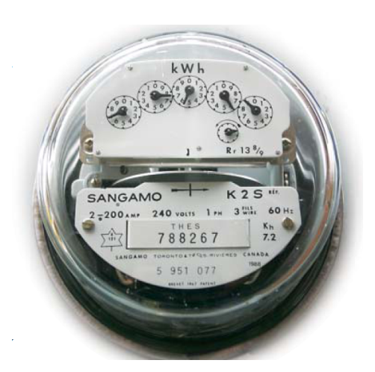
Activity 9-2B
The Cost of Electricity (page 310)
Cost of energy = $0.04 x ______ kW h
1kW h

Slide 26
Careers Related to Electricity
Brainstorm Activity: List as many as possible and share with the class

Slide 27
Energy Conversions
Not all electrical energy used to make a stove element hot is transferred to the water in a pot
Some of the energy is converted to heat energy, some is converted to light energy (red element), or sound energy (element making a cracking or popping sound as it expands)

Slide 28
Energy Efficiency
Efficiency: the percentage of energy input that is converted to a useful form. Ex: what percent of the energy used in the stove is used to heat the water (the goal)
Traditional incandescent lighting is only about 5% efficient (only 5 % of the energy is converted to light energy)
Fluorescent lighting is about 3 to 4 times more efficient (15% to 20%) at converting electrical energy to light energy.

Slide 29
Incandescent Vs Fluorescent
What are the environmental impacts of both of these types of lights? (Read page 316-317)

Slide 30
Calculating Efficiency
Efficiency =
Energy input: all of the electric energy the device took in
Energy Output: energy converted to a useful form by the device
Practice Problems: Page 318

Slide 31
Calculating Efficiency, cont’d
Incandescent lightbulbs:
Left on for 10.0h/week uses 7.0kWh of energy to supply 0.4kWh of light.
Fluorescent lightbulbs:
Left on for 10.0h/week uses 2.0kWh of energy to supply 0.4kWh of light.
Which lightbulb is more energy efficient?

Slide 32
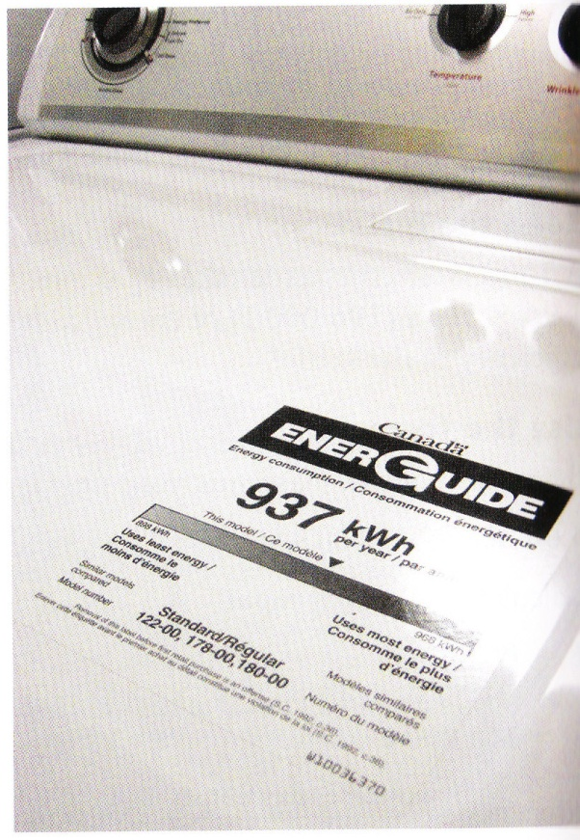
How to choose energy efficient appliances
EnerGuide Label: Label that is placed on an appliance to display how much energy the device typically uses in a year and compares its energy consumptions with other appliances in the same category.

Slide 33
EnerGuide Labels
Useful website for further information of energuide labels:
http://oee.nrcan.gc.ca/residential/personal/appliances/energuide.cfm?attr=4#household

Slide 34
Reducing the consumption of electrical energy
Improve insulation
Turn off lights when not required
Use energy efficient light bulbs
Air dry clothes when possible
Etc.

Slide 35
Core STSE
Electricity Conservation: The New Trend

Slide 36
Generators
Generator: a device that converts mechanical energy into electrical energy
Components of Generator:
Coil of wire that rotates inside a stationary magnet
Generators need an energy input such as falling water (mechanical energy) to move over a turbine
Turbine: a cylinder with blades and when water pushed the blades the cylinder turns,
This also moves the coil of wire within the magnet of a generator, creating an electric current

Slide 37
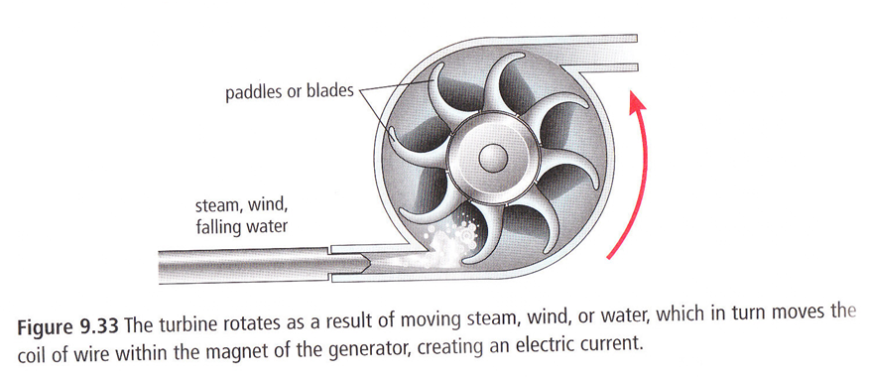
Turbine

Slide 38
Types of generating stations
Hydroelectric: uses the energy of falling or flowing water to spin a turbine.
Thermal generating station: uses heat (thermal energy) produced from the burning of fossil fuels to boil water. The resulting steam is used to spin a turbine
Nuclear generating station: uses the heat (thermal energy) released from a nuclear reaction to boil water. The resulting steam is used to spin the turbine

Slide 39
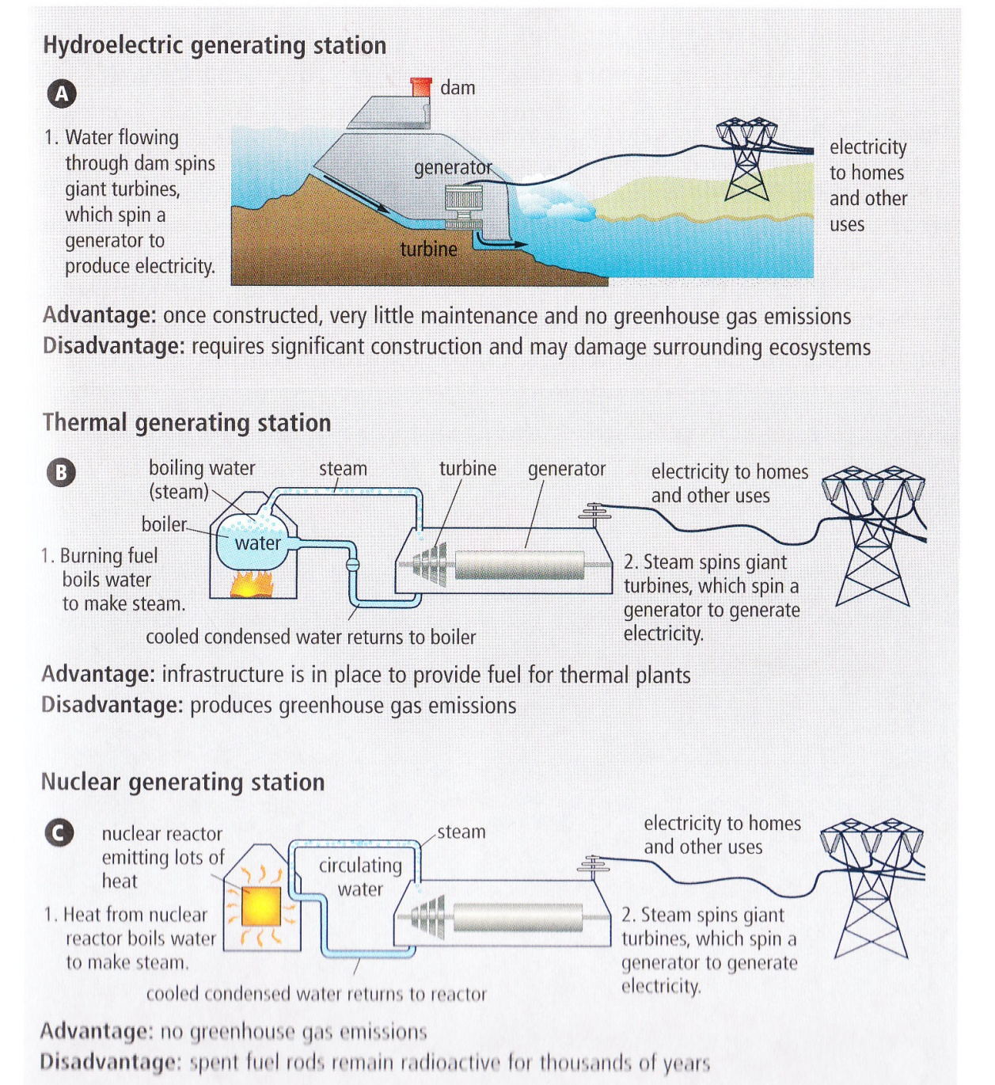
Generating stations

Slide 40
Transmission of Electrical Energy
Electrical energy is transmitted over large distances.
Energy created at Churchill falls, travels through Quebec to customers far away on the East coast of North America.
Transformers are used to step up voltage before leaving the generating station
Transformers: a simple electrical device that changes voltage
Increasing voltage decreases the current and this helps minimize power loss due to resistance in the wire. (See did you know, page 327)

Slide 41
Transmission …
Transformers are also used to step down voltage before it enters a house
Power adaptors are also transformers. They step down the voltage to the correct amount so that you can use your device (like a laptop computer)
Household use requires a voltage of 120 V and 240 V.

Slide 42
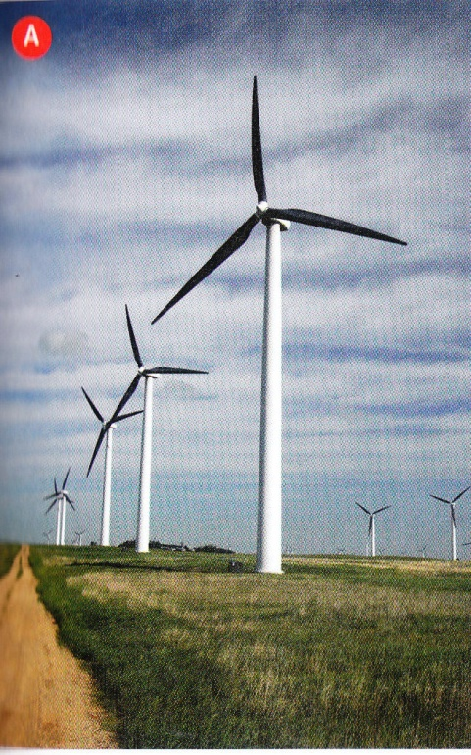
Alternative Sources of Electrical Energy
Wind Generator
Produces electrical energy using turbines
similar to those used in hydroelectric
power generation.
Can be set up in a “wind farm” that supplies
energy to an electric company or can be set up to
supply energy directly to an individual home or farm.

Slide 43
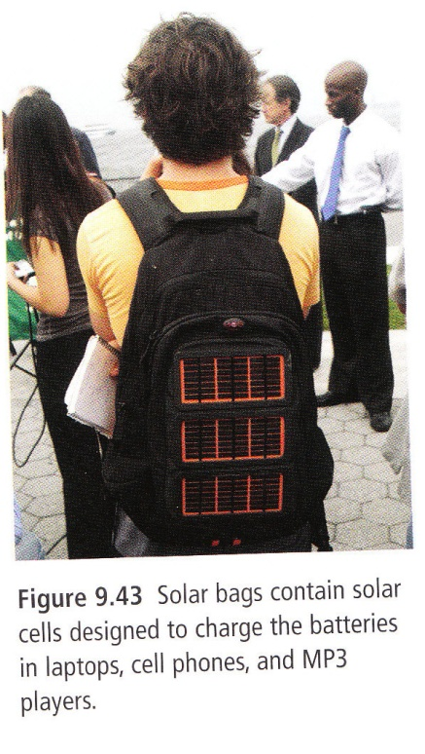
Alternative Sources of Electrical Energy
2) Solar energy
Solar cells convert sunlight into electrical
energy.
In Canada, the amount of sunlight available
is limited because we are so far north of the equator.
Fuel is free but relying on solar energy to provide electrical power for the typical home is unreasonable.

Slide 44
Alternative Sources of Electrical Energy
3) Fuel Cells
Like a battery in that it produces
an electric current using two
electrodes and an electrolyte.
Unlike a battery, a fuel cell’s
chemical components are not
consumed over time.
6 Types.

Slide 45
Alternative Sources of Electrical Energy
Activity!
Complete the following chart:
 | Wind Generator | Solar Energy | Fuel Cell
Safety Concerns
Cost
Degree of Environmental Impact

Slide 46
Factors affecting alternative sources development
Cost: Solar energy is the most expensive source per kilowatt hour
Availability of materials: energy used in a region dictates the type of energy used in that region. Ex: Wind energy is not possible in areas with little wind
Properties of materials: some materials are not practical in certain areas.

