Slide 1
Chapter 3
Elements combine to form compounds.

Slide 2
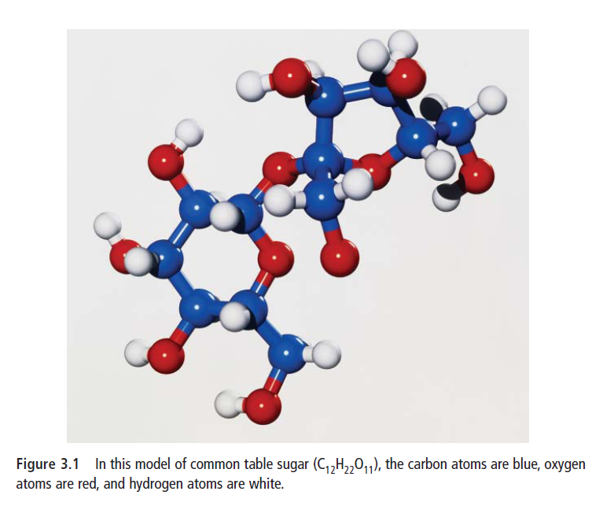
3.1 Compounds
Compounds:
pure substances made of more than one kind of element joined together.
Compounds form through
chemical bonds - links
between two or more
atoms that hold the
atoms together.

Slide 3
Compounds, cont’d
Two kinds:
1) Molecular/Covalent compounds
Compounds made of only non-metals.
These atoms combine by sharing electrons.
Ex. CH₄ (methane) or H₂O (water)
2) Ionic compounds
Compound made of a metal and a non-metal.
These atoms gain or lose electrons to form ions.
Ex. NaCl (table salt)
***So, given a compound, you are expected to know whether it is ionic or covalent because you know what are metals and non-metals on the periodic table.

Slide 4
Compounds, cont’d
Compounds are represented by a chemical formula, which tells us what elements are present, and how many of each element there are.
Compounds are written as a combination of element symbols – these are known as chemical formulas.
The numbers after each chemical symbol, let you know the proportions of elements in that compound.
Ex. H₂O – for every oxygen atom, there are two hydrogen atoms.

Slide 5
IONIC COMPOUNDS

Slide 6
Properties
All are solid at room temperature.
High melting and boiling points.
Will conduct electricity when melted or dissolved in water.
Are also called “salts”.

Slide 7
Common Ionic Compounds
You have to memorize the following ionic compounds:
1) Sodium Chloride = NaCl table salt
2) Calcium Carbonate = CaCO₃ chaulk
3) Sodium Sulfide = Na₂SO₄
4) Sodium Hydroxide = NaOH

Slide 8
Naming Ionic Compounds
You must follow these steps to name ionic compounds:
1) Name the metal ion.
2) Name the non-metal ion by ending the element name with the suffix (ending) “ide.”
3)Write down the name.
Ex. Fe₂O₃
Fe = iron; O = oxygen
Fe is the metal so we leave the name as it appears on the periodic table. Oxygen is the non-metal so we end it in “ide” = oxide.
Chemical Name = iron oxide.

Slide 9
Practice
Name the following Ionic Compounds:
1) MgBr₂
2) Li₃N
3)Ca₂S

Slide 10
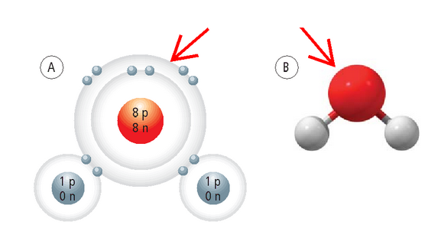
MOLECULAR/COVALENT COMPOUNDS

Slide 11
Properties
Formed from non-metals only.
They do not conduct electricity.
May be a solid, liquid, or gas at room temperature.
FYI:
Molecules: - groups of atoms that are held together by sharing one or more pairs of electrons.

Slide 12
Common Molecular Compounds
You have to memorize the following molecular compounds:
1)C₁₂H ₂₂O₁₁ = sucrose table sugar
2) CO₂ = carbon dioxide
3) CH₄ = methane
4) H₂O = water

Slide 13
Naming Molecular Compounds
Steps:
1) Name the first atom,
2) Name the second atom by ending the element with the suffix “ide.”
3) Add prefixes to the atom names to indicate the number of each atom in the compound.
4) Write the compound name.

Slide 14
Naming Molecular Compounds, cont’d
Prefixes are:
1 = mono-
2 = di-
3 = tri-
4 = tetra-
5 = penta-
6 = hexa-
7 = hepta-
8 = octa-
9 = nano-
10 = deca-
*Note: You only use mono on the second atom name. If there is only one of the first type of atom, DO NOT put “mono” in front of that name.

Slide 15
Naming Molecular Compounds, cont’d
Ex. CO
There is one atom of each chemical.
The first element is carbon, the second is oxygen. We leave the element name carbon as it is because there is only one. Oxygen, we add an “ide” to the end making it “oxide” and there is only one so we have to add our prefix to the beginning (mono). It now becomes “monoxide”.
Carbon monoxide

Slide 16
Naming Molecular Compounds, cont’d
SiCl₄
The first element is silicon and there is only one so we leave the name as it is. The second element is chlorine so we have to add “ide” to the end making it chloride. There are four of them so we have to add the prefix “tetra.”
Silicon tetrachloride.

Slide 17
Naming Molecular Compounds, cont’d
Name the following molecular compounds:
1) C₂H₆
2) NH₃
3) SF₆

Slide 18
Practice Problems
Name Ionic Compounds
Page 82 Practice Problems
Every second part
Name Molecular Compounds
Page 83 Practice Problems
All parts

Slide 19
3.3 Physical and Chemical Changes

Slide 20
Physical Changes
Physical Change
A change in matter in which the appearance may change but no chemical bonds are broken or made and no new substance is formed.

Slide 21
Physical Changes, cont’d
3 types of physical change are:
1) Change of State
Melting – solid to a liquid; Freezing – liquid to a solid.
Boiling/Evaporationg – liquid to a gas; Condensing – gas to a liquid.
2) Cutting
Breaking into smaller pieces.
3) Dissolving
Mixing two substances together. Ex. Salt in water.

Slide 22
Chemical Change
Chemical Change
A change in matter in which chemical bonds are formed and broken and at least one new substance is formed.

Slide 23
Chemical Change
3 types of Chemical change include:
1) Corrosion
Process by which metals react with oxygen.
2) Fruit Ripening
3) Combustion
Burning a chemical (a reaction with oxygen) which results in the release of a large amount of energy (heat).

Slide 24
Chemical Change
Evidence of a chemical change:
1) heat, light or sound is produced or absorbed
2) a new colour appears
3) a precipitate (the formation of a solid in a solution) is formed
4) bubbles of gas form
5) the process is difficult to reverse

Slide 25
Chemical change, cont’d
During a chemical change, elements are conserved but compounds are not.
This means that the same number of the same elements will still exist but the compounds are broken down and formed into new ones.

Slide 26
Chemical change, cont’d
For example:
In the above ‘chemical reaction’, the number of small, coloured blocks remains the same, but they are used to make different large blocks.

Slide 27
Chemical change, cont’d
A more chemistry-like example:
CH₄ + 2O₂ CO₂ + 2H₂O
The number of atoms remains the same but the compounds have changed.
***Note: You are not expected to know chemical reactions yet so don’t panic.

