Slide 1
Chapter 2
Elements are the Building Blocks of Matter

Slide 2
Elements
Element: a substance that contains only one kind of matter and cannot be broken down or separated into simpler substances.
Chemical Symbol: all elements have a chemical symbol
One or two letters, if only one then it is capitalized, but if two then the first is capitalized and the second is not.
These internationally recognized symbols (IUPAC) create easy communication between scientists of different nations and give a common scientific language.

Slide 3
Twenty Common elements
Symbol is the first letter in name | Symbol is made from two letters in its name | Symbol is based on non-English name
Hydrogen (H) | Magnesium (Mg) | Sodium (Na)
Carbon (C) | Calcium (Ca) | Potassium (K)
Nitrogen (N) | Nickel (Ni) | Iron (Fe)
Oxygen (O) | Zinc (Zn) | Copper (Cu)
 | Neon (Ne) | Silver (Ag)
 | Helium (He) | Gold (Au)
 | Chlorine (Cl) | Mercury (Hg)
 | Silicon (Si) | Lead (Pb)

Slide 4
Question to consider…
What is the difference between Co and CO? (hint look at the periodic table for help)

Slide 5
Dmitri Mendeleev
He organized the known elements at the time according to their known chemical and physical characteristics
He recognized that spaces needed to be held for elements that had yet to be discovered
He left gaps in his table and suggested that elements would be found to fill these gaps

Slide 6
Mendeleev’s Periodic Table
There are a lot of gaps, but look at the horizontal rows (periods)
and compare to the current periodic table.

Slide 7
Current Periodic Table

Slide 8
Periodic Table
Periodic table: a chart that organizes all known elements according to their physical and chemical properties
Most versions include the element’s name, symbol, atomic number and the atomic mass
Atomic Number: equals the number of protons in the nucleus in each atom and …
equals the mass of the protons in the nucleus (measured in atomic mass units, amu)
equals the number of electrons in each atom of an element

Slide 9
Atomic mass: the average mass of the atoms in an element. It is written as a decimal and is also measured in amu.
Atomic mass = # of protons + # number of neutrons
Complete Activity 2-2A: page 49

Slide 10
Complete Activity 2-2A: page 49

Slide 11
Elements are grouped on the basis of similar characteristics
Three major groups formed are: Metals, non-metals and Metalloids
Ductile: ability of a substance to be pulled or stretched
Malleable: ability of a substance to be bent or molded into different shapes
Metals | Non-metals | Metalloids
Shiny Ductile Malleable Conducts heat Conducts Electricity | Dull Non-ductile Non-malleable Does not conduct heat Does not conduct electricity | Shiny or dull Not ductile Not malleable Poor heat conductor May conduct electricity

Slide 12
Period: a horizontal row, Number from 1 to 7
Chemical Family or group: a vertical column. The elements in a family or group have similar chemical and physical characteristics. They are numbers 1 to 18.

Slide 13
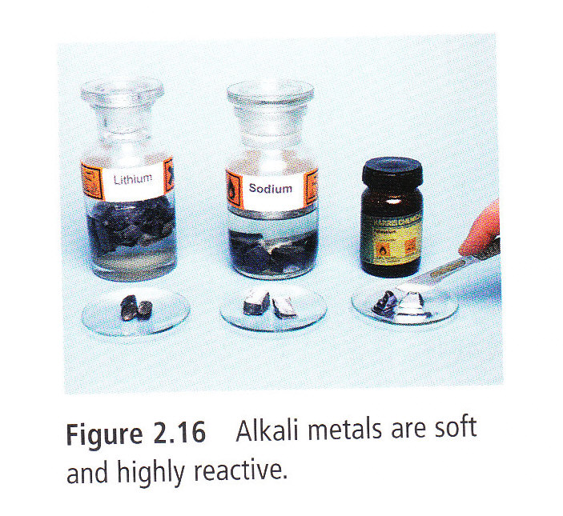
Families 1: Alkali Metals
Alkali Metals (Column 1)
Very reactive and soft
React with water, oxygen and other non-metals
Low melting points
Reactivity increases as you move down the column

Slide 14
Family 2: Alkaline Earth Metals
Alkaline Earth Metals (column 2)
Less reactive than Alkali Metals
Burn in air if heated, produce bright flames and used in fireworks
Also reacts with water
Reactivity increases as you move down the column

Slide 15
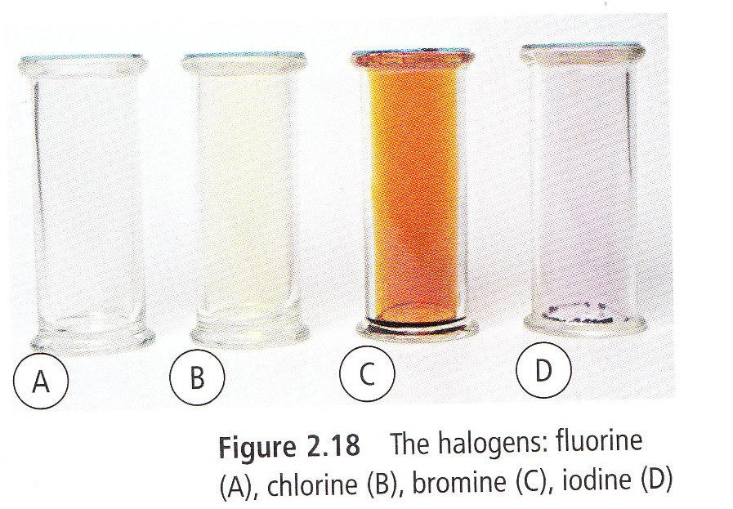
Family 17: Halogens
Halogens (Column 17)
Non-metals and highly reactive
Fluorine and Chlorine are gases, Bromine is a liquid.
Reactivity decreases as you move down the column
Astatine is very rare and little is known about it

Slide 16
Family 18: Noble Gases
Noble gases (column 18)
Most stable and unreactive
At room temperature they are colorless and odorless
Some gases, like Argon and Neon are used in light fixtures
Helium is lighter than air and is used in balloons.

Slide 17
Transition metals
Found at the centre of the periodic table.
Have the same characteristics as the other metals.
Grouped together because the arrangement of their electrons is complex.
Not a chemical family because they are spread out over 10 columns.
Only known magnetic elements: iron, cobalt, and nickel.

Slide 18
Locating Elements on the Periodic Table
Make sure you can identify the relative position of elements on the periodic table
What element is located at period 2, family 3?
Boron

Slide 19
Why is Hydrogen special?
It occupies a unique position because sometimes it acts like a metal and sometimes it acts like a non-metal
Sometimes included with alkali metals or with the halogens or off by itself.
Questions: pg 59, 4-6, 9-13, 17-21

Slide 20
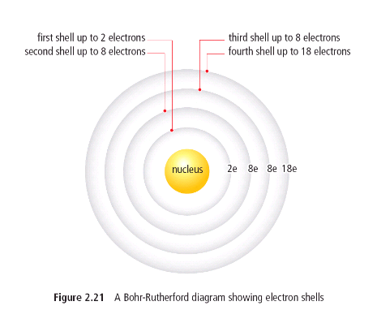
Bohr-Rutherford Diagrams
These diagrams show how many electrons are in each energy level surrounding the nucleus.
The first energy level can hold 2e^{-’}s, the second and third can hold 8e^{-’}s each and the fourth can hold 18.
Figure 2.21 page 60

Slide 21
Bohr-Rutherford Diagrams, cont’d
How many electrons can fit in the first energy level?
How many electrons can fill up the first two energy levels?
How many electrons can fill up the first three energy levels?
How many electrons can fill up the first four energy levels?

Slide 22
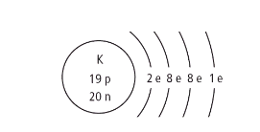
Bohr-Rutherford Diagrams, cont’d
Includes:
1) element symbol
2) number of protons
3) Number of neutrons
4) Physical location of the electrons
An example of a Bohr-Rutherford model for potassium is shown below:

Slide 23
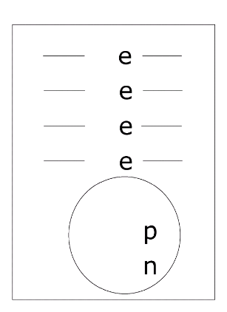
Bohr-Rutherford Diagrams, cont’d
When filling each energy level in an atom, you have to fill the first level (2 electrons) before you can fill the second level (8 electrons) and then the third and fourth.
Let’s do a Bohr-Rutherford
diagram for Calcium.

Slide 24
Bohr-Rutherford Diagram Template

Slide 25
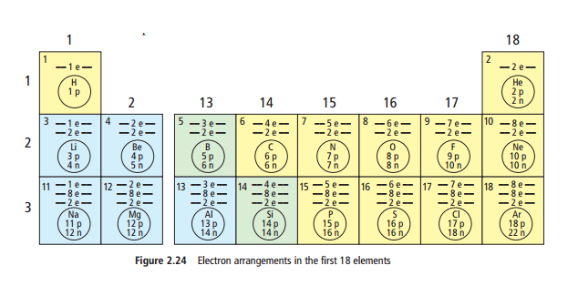
Bohr-Rutherford Diagrams, cont’d
Now it’s up to you to complete the Bohr-Rutherford diagrams for elements with atomic numbers 1 through 18.

Slide 26
Important Definitions:
Energy level:
A region surrounding the nucleus of an atom; may be occupied by electrons.
FYI: electrons further away from the nucleus have higher energies.
Valence Energy Level (Shell):
The outermost energy level that is occupied by electrons; differs for different atoms.
Valence Electron:
An electron in the outer most energy level of an atom; responsible for that atom’s chemical properties.

Slide 27
Patterns observed Using energy level diagrams
Elements in the same family have the same number of electrons in their valence energy level
Period number indicates the number of energy levels
The valence energy level structure determines how one element will react with another
If the valence level is full, then it is difficult to react (look at Noble gases)

Slide 28
Noble Gas Stability
The noble gases are normally unreactive, which means the atoms do not form new substances with other atoms.
Because their valence shell is full, they do not try to gain or lose electrons. This makes them stable.
(How new substances gain and lose electrons to form will be covered in Chapter 3)

Slide 29
Questions
Page 67 Questions 1-5, 7-8, 13-14

